Slide 1

Darren Redmond
Learn International
2018-05-30
https://github.com/darrenredmond/learn_international
Notes:
Video: Understanding Big Data http://inside-bigdata.com/2012/12/26/video-understanding-big-data/

Slide 2
Lecture Overview
Big Data
Tools for Big Data & Data Analytics
Visualisation Best Practices
Business Intelligence – Extracting Value
Data Privacy - GDPR

Slide 3
Big Data
Massive volumes of diverse and rapidly growing data
Mostly unstructured, semi-structured, lightly structured
Heterogeneous
Relational DBMS cannot achieve good performance to handle complex queries on Big Data

Slide 4
Source of Big Data
Cell Phones
Ecommerce Websites for example, Amazon.com, etc.
Medicine
Social networks
Internet of Things - Sensors

Slide 5
Big Data - Definition
No one definition
Very fast
Many sources
Different formats
3 V’s – Volume, Velocity, Variety
Are there more V’s

Slide 6
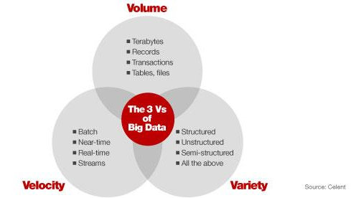

Slide 7
Volume
Storing data reliably for processing
Data worth for storage
Transactions
Logs
Business data
Sensor data
Medical Data
Social such as email, twitter, etc.
Storing and processing on a storage area network can take long time

Slide 8
Variety
Databases and Data warehouses have been used for long time
Used for storing structured data
Data is available in many formats
For examples, a bank might have list of your account transactions, scans of your cheques, records of your interactions with customer service agents on Web or over phone
Traditional databases fail to store data in different formats
Hadoop can store data in any format, manipulate and reformat it later

Slide 9
Velocity
Data is increasing in terabytes every day
It is hard to store such big amounts of data which can be useful
But some of it is discarded
Spending few minutes in an ecommerce website
Several recommendations can be made

Slide 10
Solving Big Data Problems
Plenty of information can be gathered from big data
It should be stored in a cost-effective way
We should be able to process it efficiently
Foundations of Hadoop

Slide 11
More Vs
Big Data
Volume
Veracity
Variety
Velocity
Value

Slide 12
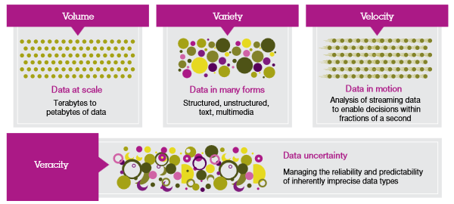










Notes:
http://www.practicalecommerce.com/articles/3960-6-Uses-of-Big-Data-for-Online-Retailers

Slide 13
Veracity
Uncertainty of Data
It’s hard to know which information is accurate and which is out of date. This is why one in three business leaders do not trust the information they use to make decisions.
Poor data quality costs the U.S. economy around $3.1 trillion each year, giving scientists a huge incentive for establishing systems that maintain the veracity of data.

Slide 14
Value
Businesses should make a business case for any attempt to collect and leverage big data.
Cost Benefit Analysis
Investing in big data technologies/analytics may not be a good idea unless you can achieve Value.
Big data means big business and every industry will reap the benefits from big data.
McKinsey states that potential annual value of big data to the US Health Care is $ 300 billion, more than double the total annual health care spending of Spain.

Slide 15
More V’s?
Variability
Variability means that the meaning is changing (rapidly). E.g. the same words having a totally different meaning in different contexts. This is very relevant if companies wish to perform sentiment analyses.
Visualisation
Making all that vast amount of data comprehensible in a manner that is easy to understand and read. With the right analyses and visualizations, raw data can be put to use otherwise raw data remains essentially useless

Slide 16
More V’s?
For further reading you should read the following:
http://www.wired.com/2013/05/the-missing-vs-in-big-data-viability-and-value/
http://www.informationweek.com/big-data/big-data-analytics/big-data-avoid-wanna-v-confusion/d/d-id/1111077?
http://inside-bigdata.com/2013/09/12/beyond-volume-variety-velocity-issue-big-data-veracity/
Video: How to Successfully Manage the Four V's of Big Data http://inside-bigdata.com/2013/01/04/video-how-to-successfully-manage-the-four-vs-of-big-data/

Slide 17
Big Data Tools
Tableau
Excel
Power BI
Rapid Miner
R & Python
SAS / SPSS
Google Fusion Tables & Charts
D3.js
Nosql Databases – Hadoop, Teradata

Slide 18
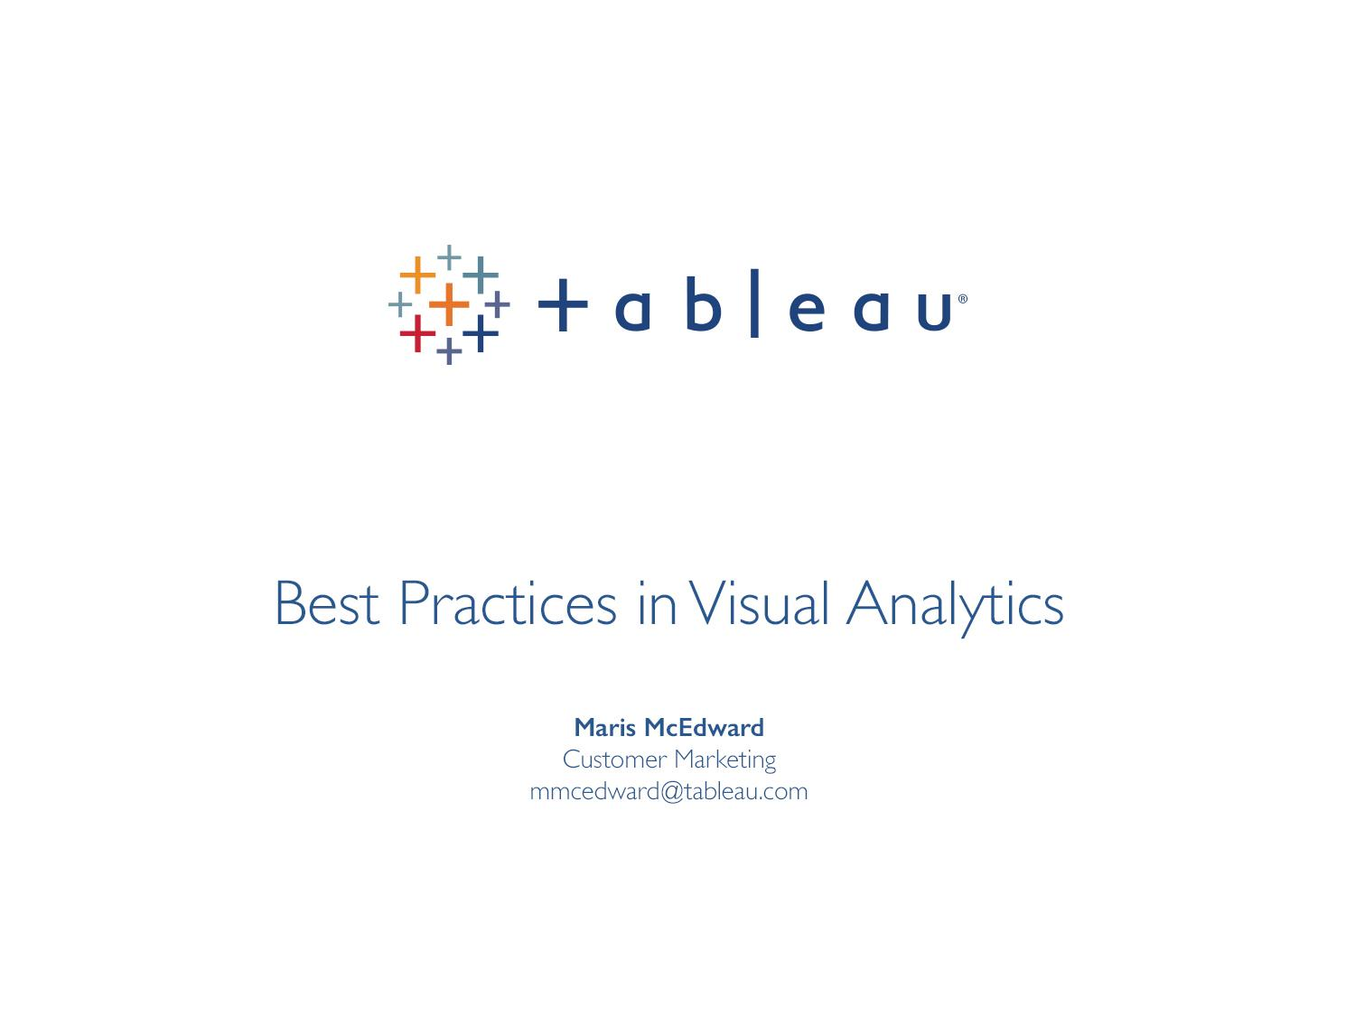

Slide 19
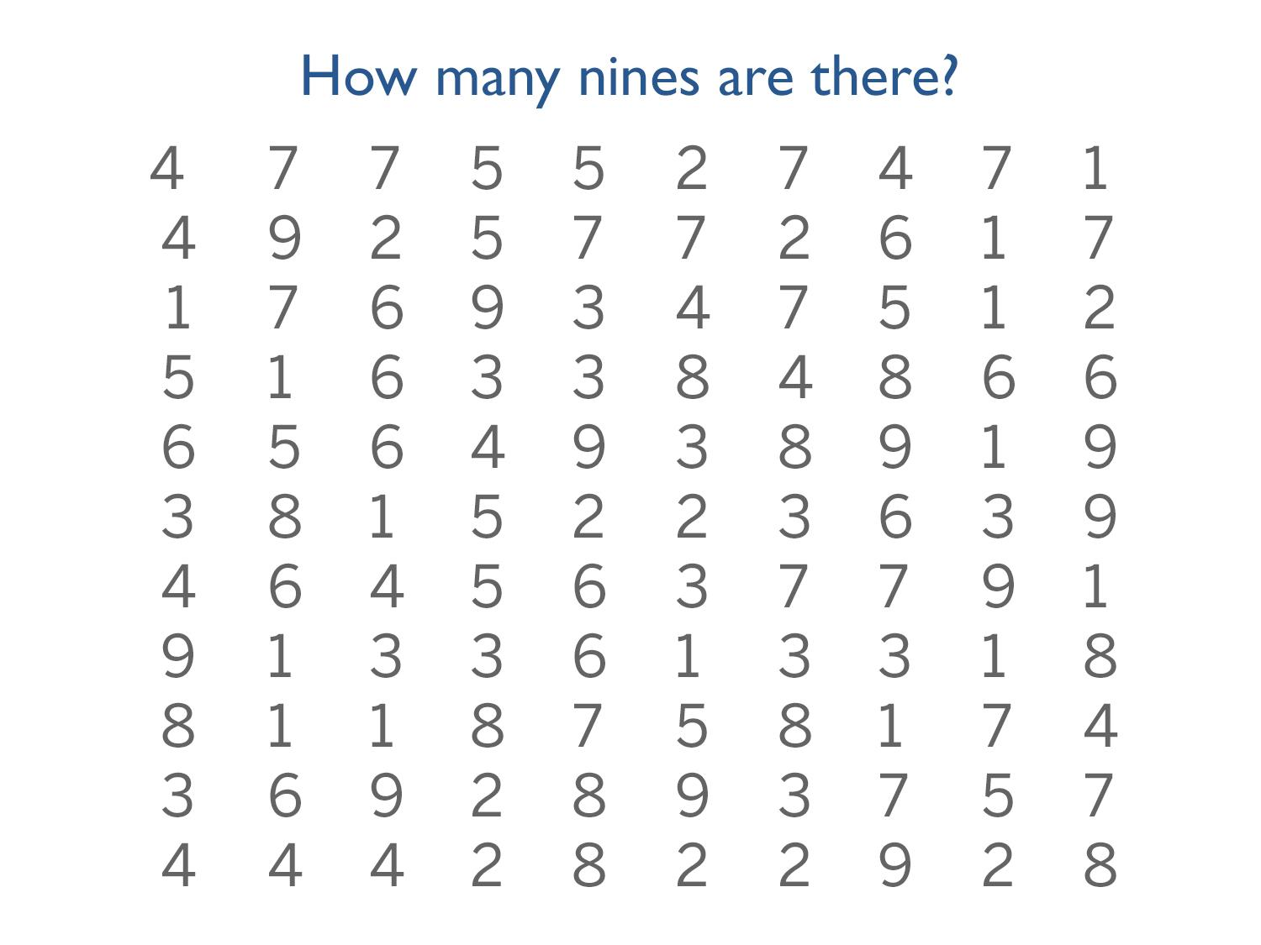
Notes:
I like to start these sessions off with a game I call “count the nines.” So, count the nines. Raise your hand when you think you know how many nines there are on here. [pause] In fact, just go ahead and shout it out. If you know how many nines are on here, shout out the answer. [pause]

Slide 20
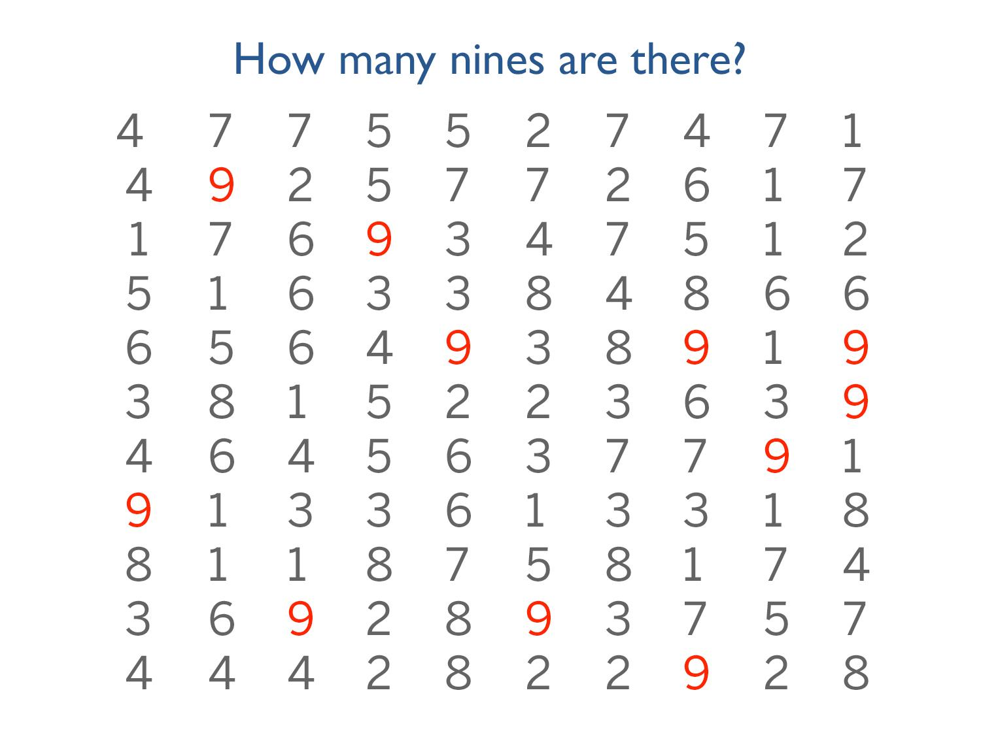
Notes:
NOW count the nines. How many nines do you see? Raise your hand when you know. (There are 10 nines)
It’s amazing how much easier it is to find and see the nines as soon as they’re picked out in red.

Slide 21
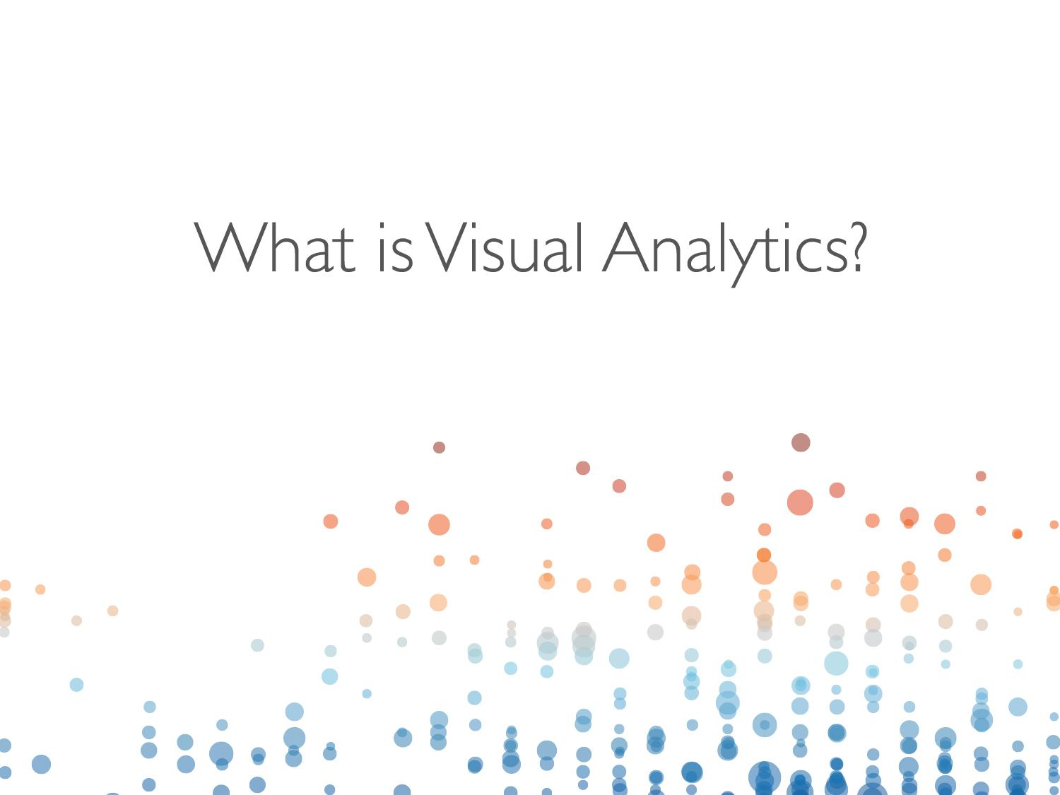
Notes:
So what is visual analytics? THAT’s visual analytics.
The “count the nines” game is a, granted, simple example of visual analytics but it is a form of visual analytics nonetheless.

Slide 22
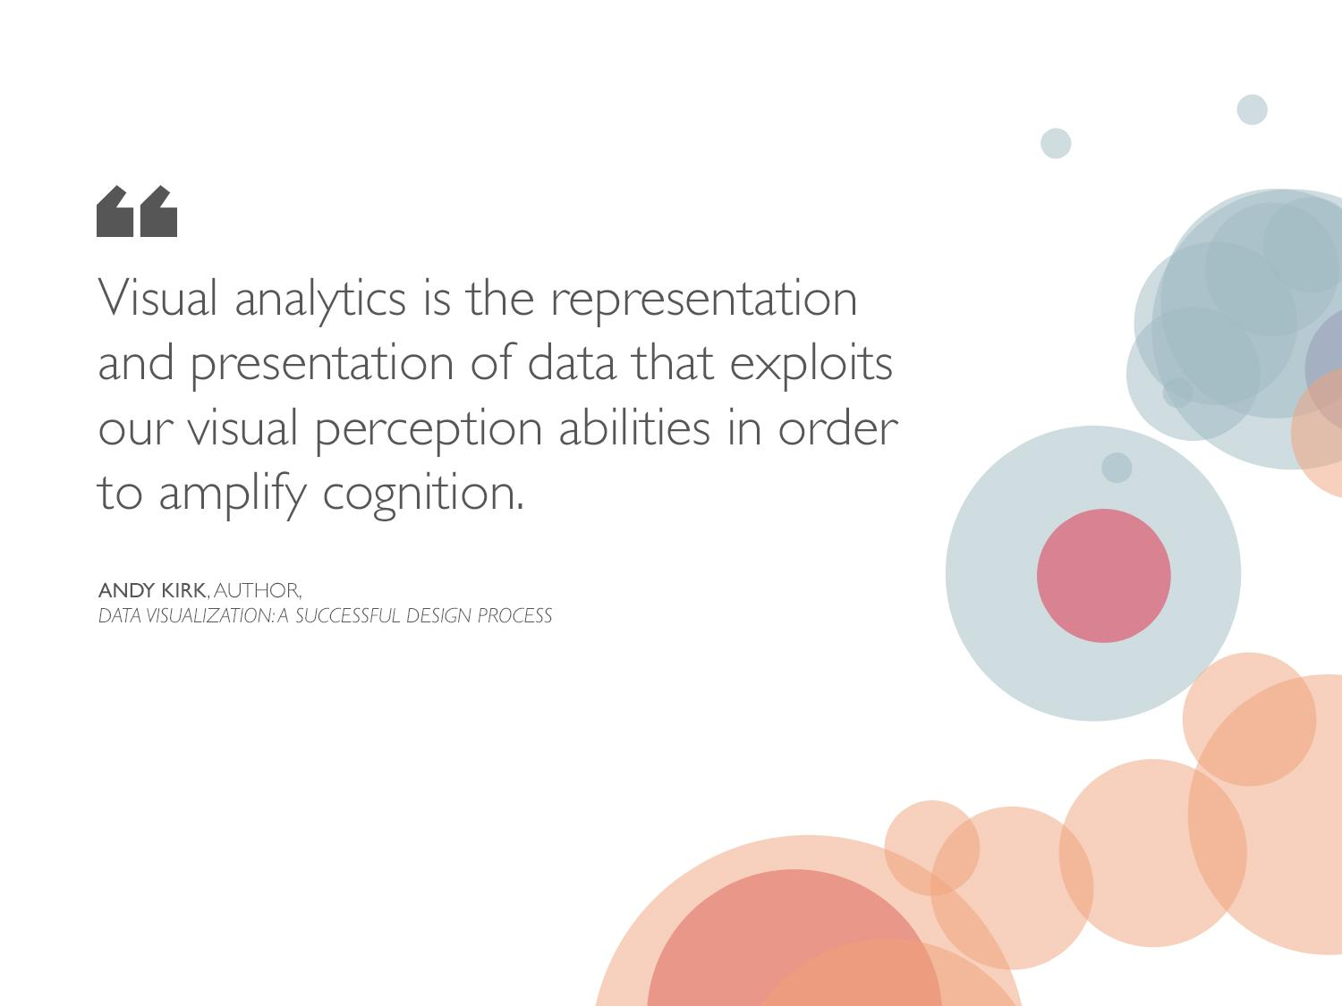
Notes:
[Give the audience a few seconds to read the quote]
Those are really fancy words for what you just experienced. Basically, what Andy Kirk is saying, is that visual analytics is the system by which people use our innate visual perception strengths to find patterns and insights in data.
Let’s look at another example:

Slide 23
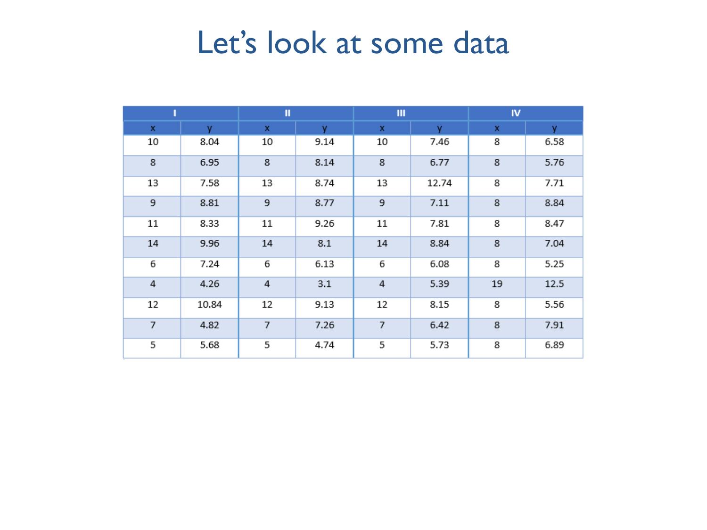
Notes:
Let’s see another example. Here’s some data. The are 4 sets of data here, each with 11 sets of x-y coordinates.
For the purposes of this exercise, let’s assume the x data represents, in millions, the net sales of a single retail store over the course of a month. Let’s say the y data represents, in millions, the total profit from that store. So what we’re looking here is a set of points that represent profit by sales, where each row is a single store. The four data sets represent regions, say, West, Central, South and East.
Let’s say you’re a manager responsible for the profits of each of these stores and your accounting department hands you this data set to help you prep for a meeting with senior leadership to discuss profit trends for each region.
What conclusions can you draw from these 4 sets of data? What would you be able to say at the meeting with senior leadership?

Slide 24
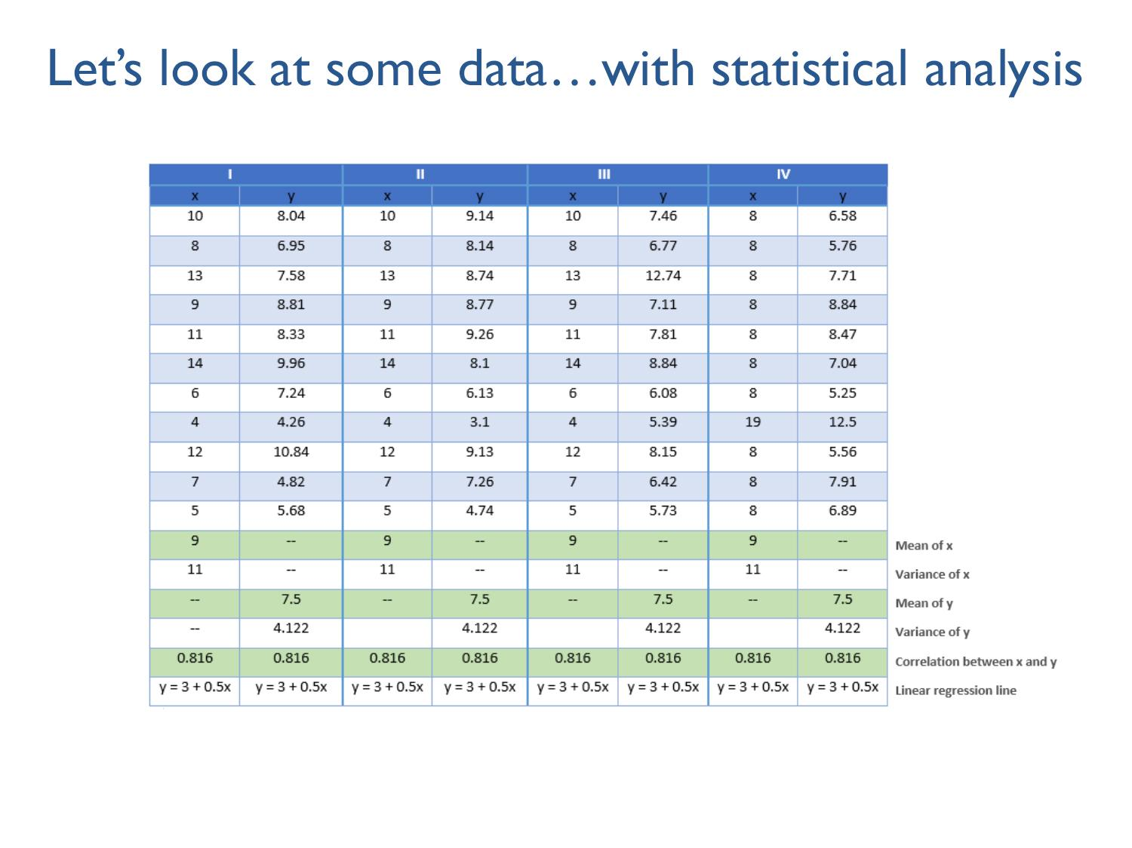
Notes:
OK, OK, so you’d typically have a bit more information than that when you’re making a decision.
So now let’s look at some more information about these data sets. Maybe we can learn something about them by running a few simple statistical tests. Determining the mean, variance, correlation and linear regression are fairly standard statistical analyses and while they do tell us more about our data, what insights can we draw form this extra information?
Honestly, not much. It turns out that these four data sets all have the same means, the same variances, the same x-y correlations, and even boil down to an identical linear regression.
In fact, it looks like these four data sets are practically identically based on this analysis.
So, let’s go back to our questions: What conclusions can you draw from these 4 sets of data? What would you be able to say at the meeting with senior leadership?

Slide 25
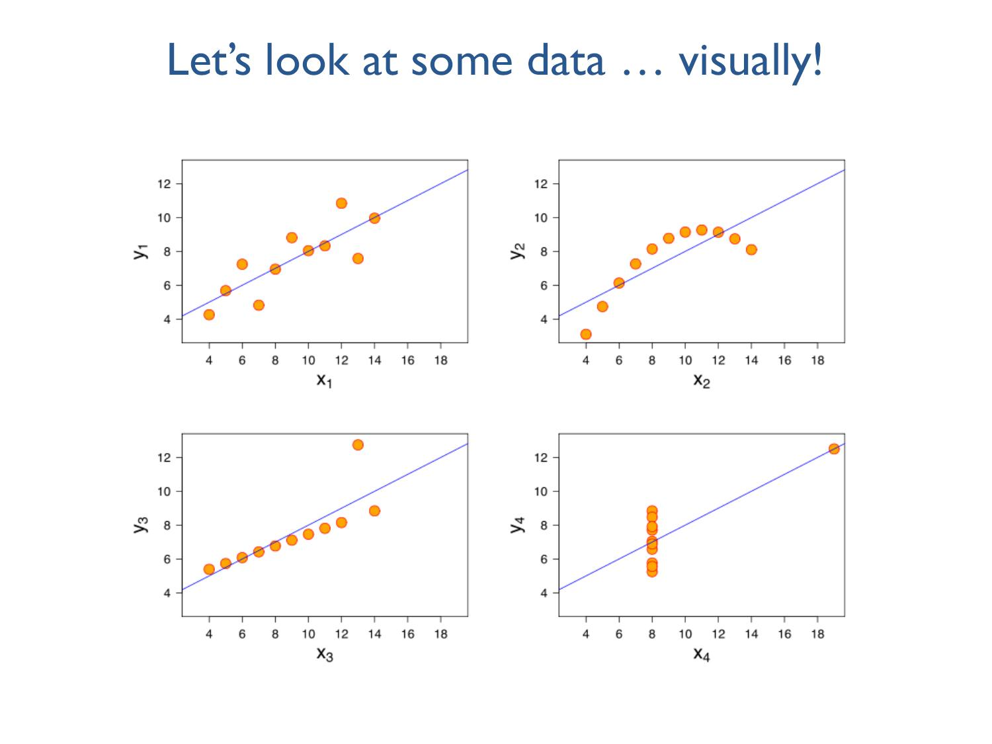
“Anscombe’s Quartet”
Source: Wikipedia
Notes:
Whoa!
When all we see is the summary analysis like on the previous slide, we’re missing key information about these data sets – the shape of their distributions. That insight only comes out when we analyze the data visually.
It wasn’t until we looked at the visualization of the data that we saw the real story hidden in the numbers.
So, what would you be able to say to senior leadership now? [Let the audience make some suggestions. You can chime in with things like, “Yeah, you might want to talk to the manager of the outlier in set 3 and see what she’s doing right” or “You might want to talk to the managers of some of the stores in set 4 and see why their profits are underperforming compared to stores with similar sales.”]
What other pieces of information might you want? [Let them make suggestions, and if necessary you can chime in with things like “You might want to see how many orders each store is producing, or what categories of product they’re selling most, or how frequently they offer discounts.”]
Those of you with a stats background are familiar with this collection of data: it’s called Anscombe’s Quartet and it’s a brilliant example of the power of visual analysis in helping us gain accurate insights from data.

Slide 26
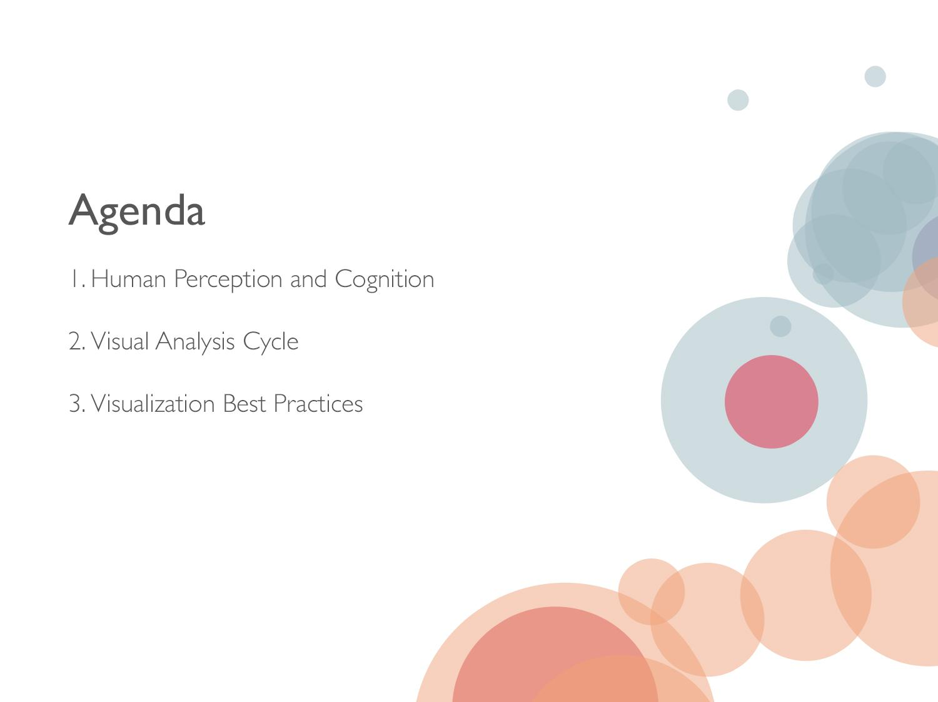
Notes:
So, we’ve gone over a few examples that illustrate why visual analysis matters – now let’s dive into the heart of the talk: human perception and cognition and the visual analysis cycle and how an understanding of both helps shapes visualization best practices.

Slide 27

Notes:
Visual analysis leverages our innate perception skills – but how do we perceive naturally and what perception skills do we humans have that help us understand and gain insights into the world around us?

Slide 28
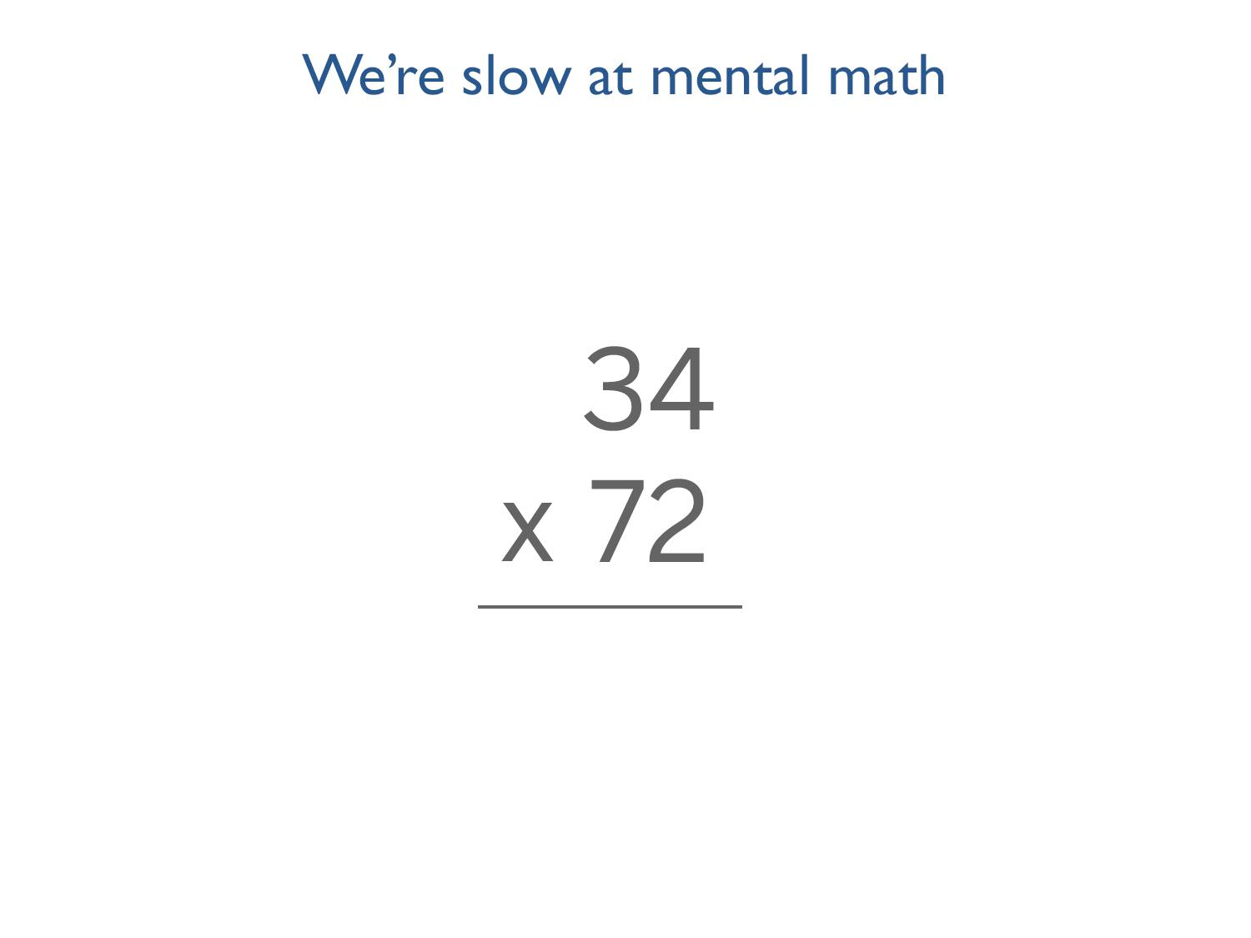
Notes:
Humans are slow at mental math. We’re not designed to manipulate complex numbers in our heads. Go ahead and try to solve this multiplication problem in your head.

Slide 29
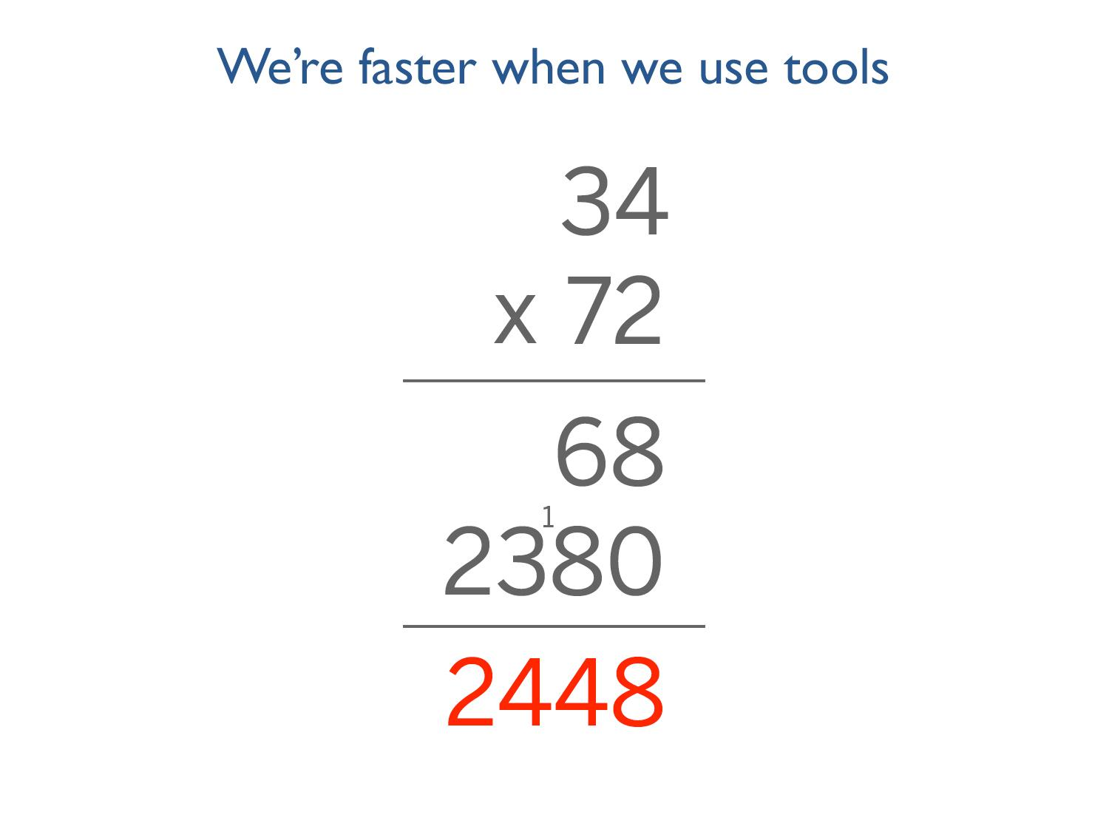
Notes:
If we give you a pencil and paper, all of a sudden this problem becomes a lot easier to solve.
In fact, we’re 5 times faster when we’re able to use tools – in this case, pencil and paper, to solve math problems.
It takes educated people an average of 50 seconds to solve this problem in their heads. Give then the right tools, and suddenly they’re able to solve it in about 10 seconds.

Slide 30
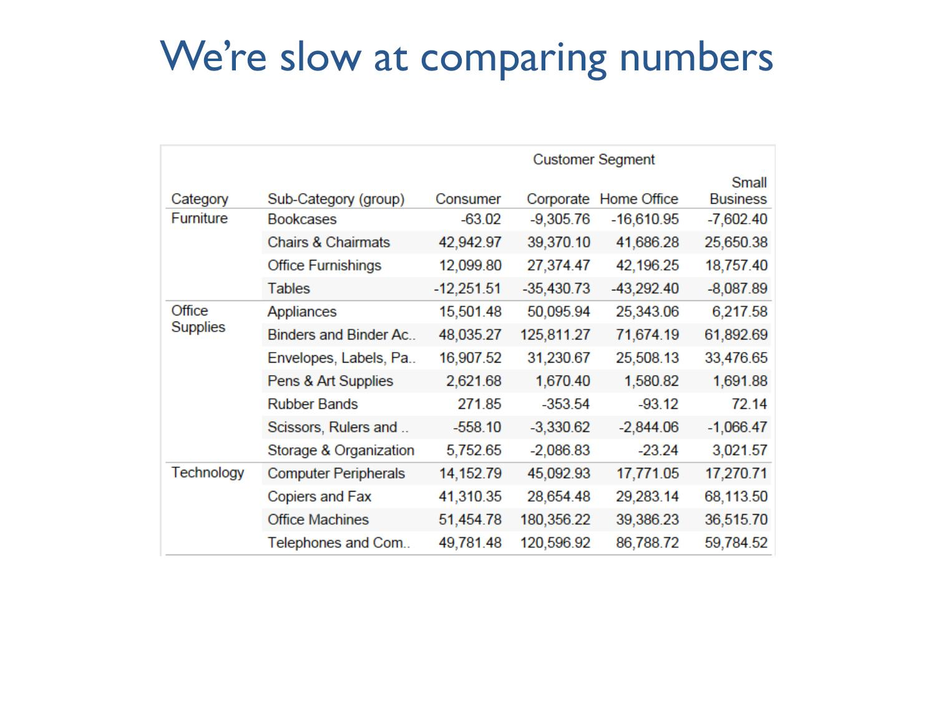
Notes:
Which product subcategory is the most unprofitable?

Slide 31
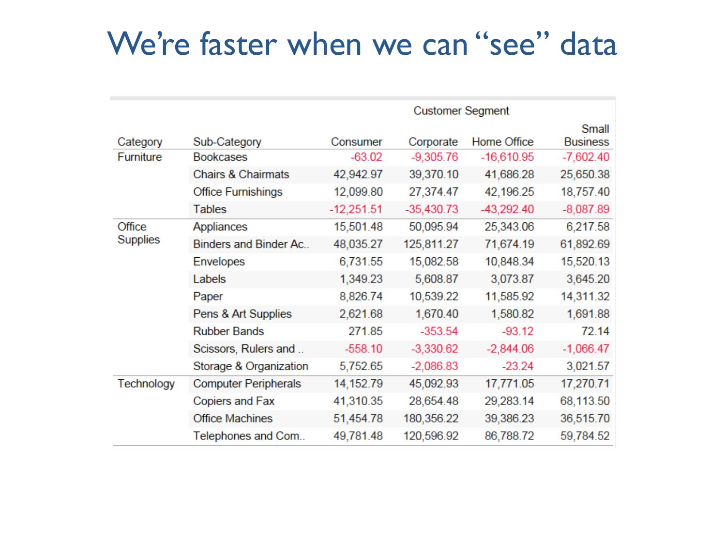
Notes:
Again: which product subcategory is the most unprofitable?
In this case, as humans, we effortlessly know that red means “pay attention” and in this data set, our eyes – completely subconsciously – are drawn to the red numbers. We’re able to perform visual analysis on this data set in a matter of milliseconds to hone in on the 5 rows with unprofitable customer segments. The amount of data we’re processing is much smaller and further analysis is easier.
But we’re still comparing numbers…

Slide 32
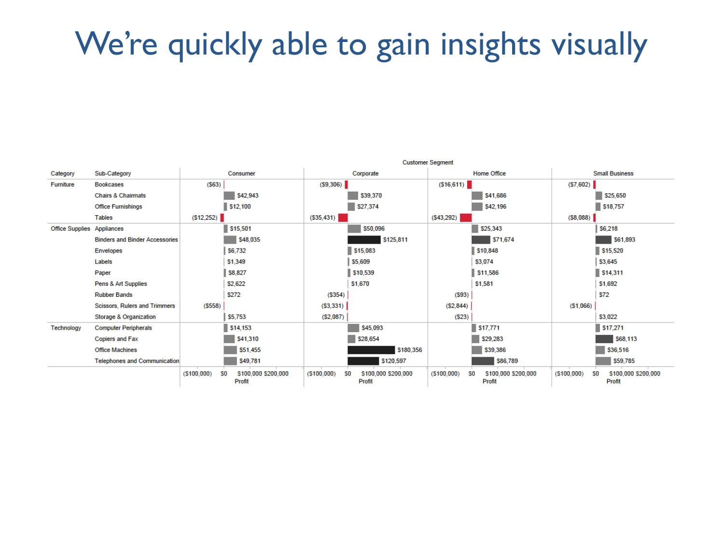
Notes:
Now … which product subcategory is the most unprofitable? You can instantaneously see that Tables for the Home Office customer segment are the least profitable.
In this instance, there are visual analysis cues that supported human’s nature perception triggers – in this case, both color and size comparison. While the previous data set helped us hone in on the important numbers through color, in this case, we aren’t being asked to do any number comparisons – and remember, numbers are actually very complex and largely theoretical, in this instance we are able to visually perceive insights without having to do any numerical comparison or in-depth processing.
The comparisons we are doing are around the relative length of the bars in the chart, the color differences. And as with the math problem, when we’re given the right tools, our ability to get to the “answer” in this case –the analysis – is much, much faster.
In fact, I’m sure for most of you, the answer to which product category is the most unprofitable you’ve already moved on to thoughts like, wow, office machines for the corporate segment are doing really well! Or, technology is by far our most profitable product category regardless of customer segment.

Slide 33
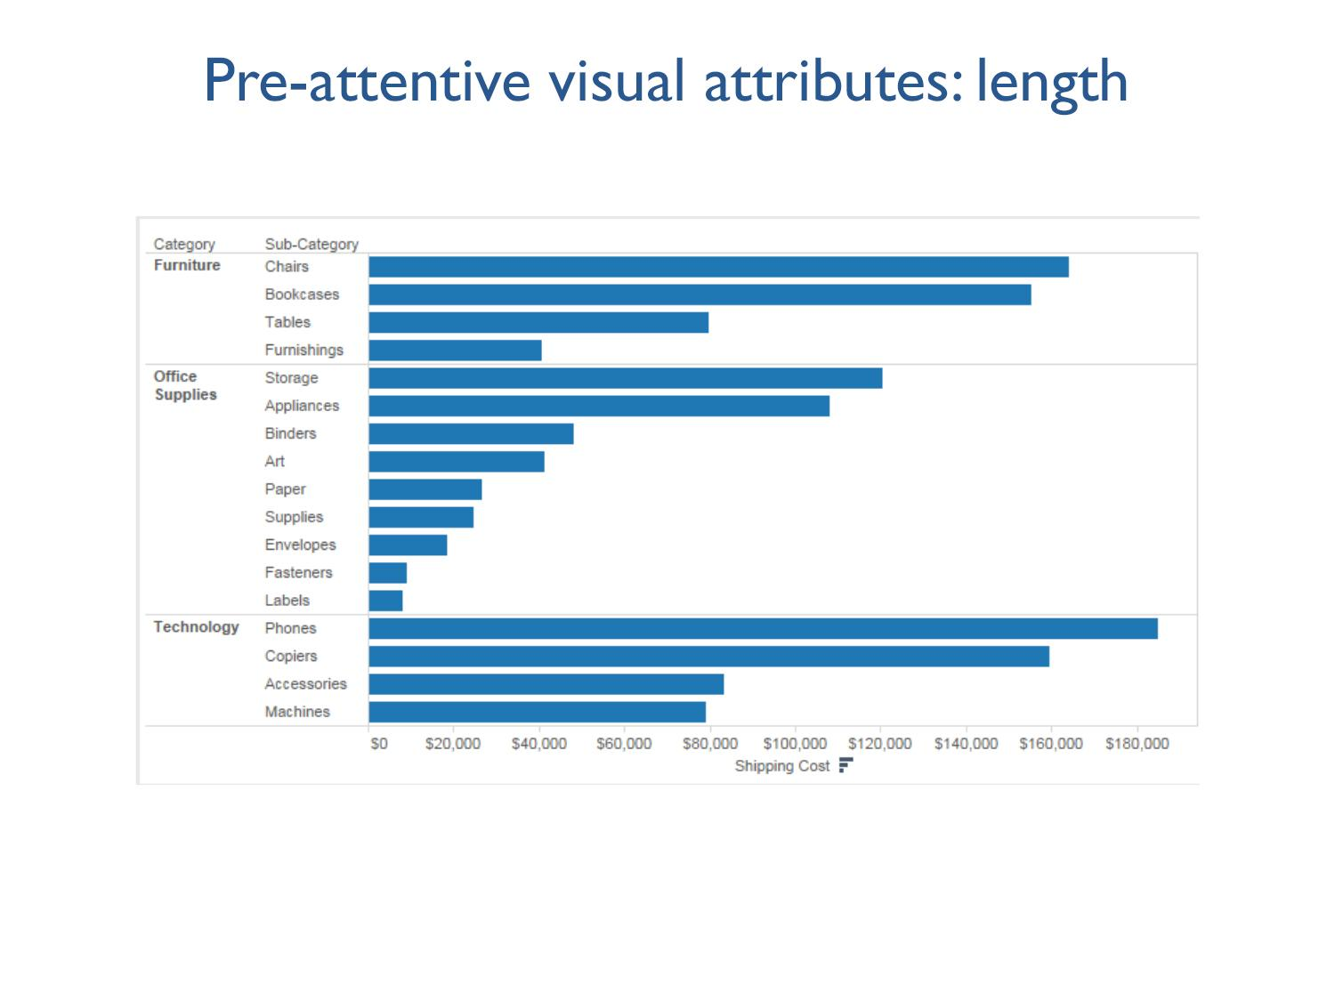
Notes:
So, as we saw in that example, there are certain visual cues that jump out at us and help us to rapid visual analysis – we call these cues “pre-attentive visual attributes”
Pre-attentive attributes are information we can process visually almost immediately, before sending the information to the attention processing parts of our brain. Length is one of these attributes.
It’s easy, in this example, to see what’s different and where there are patterns we might want to pay attention to.

Slide 34
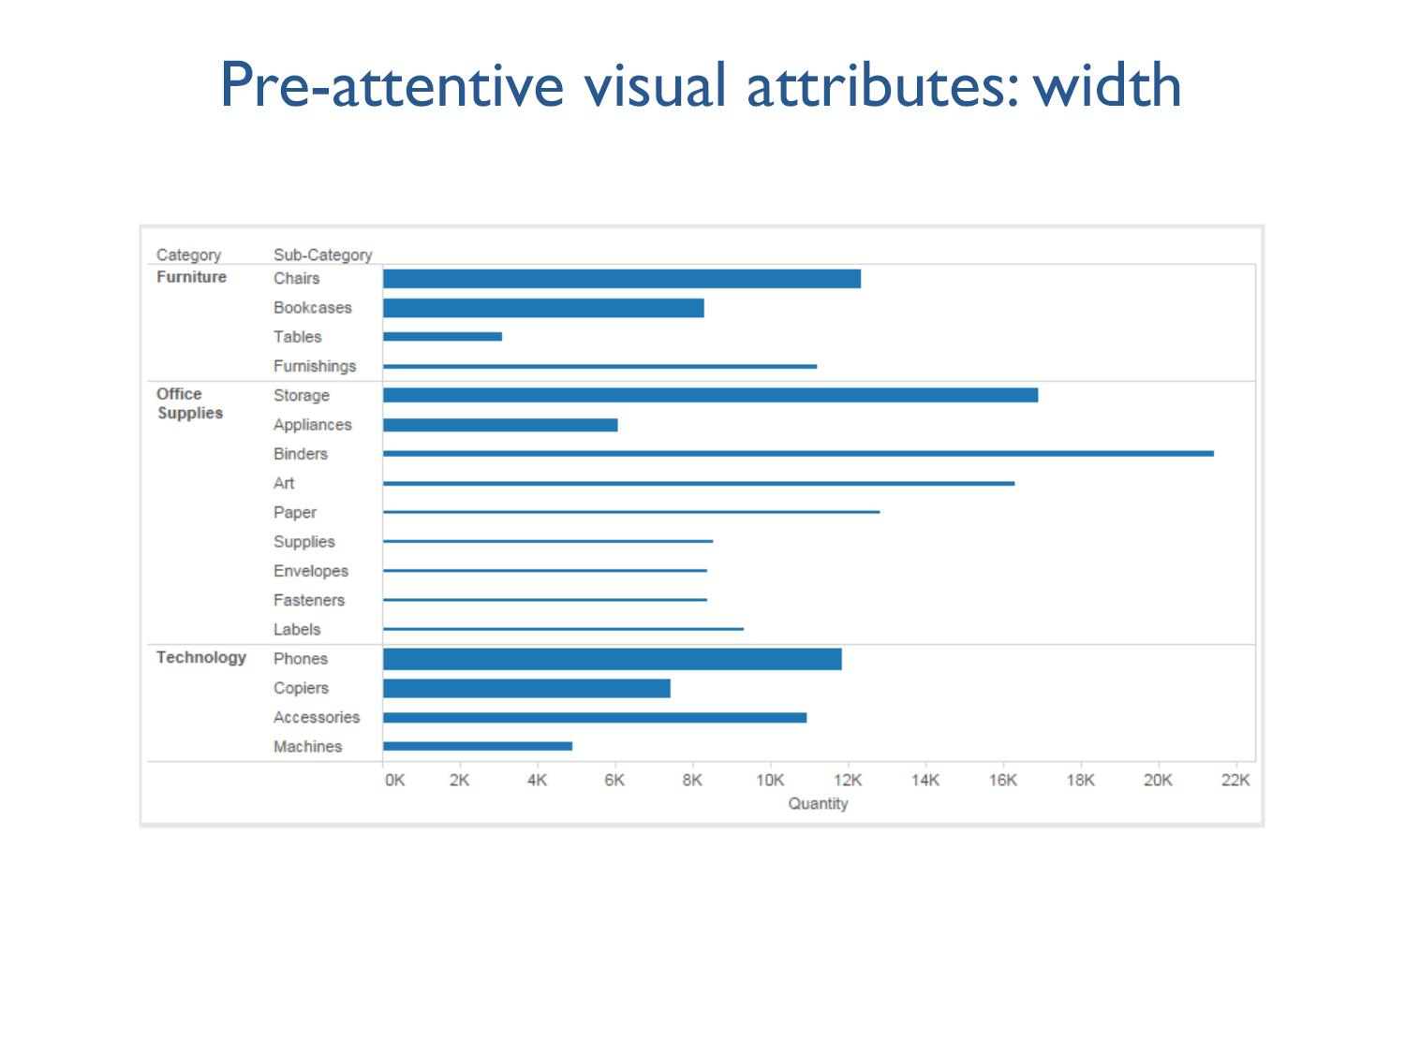
Notes:
Width is another example.

Slide 35
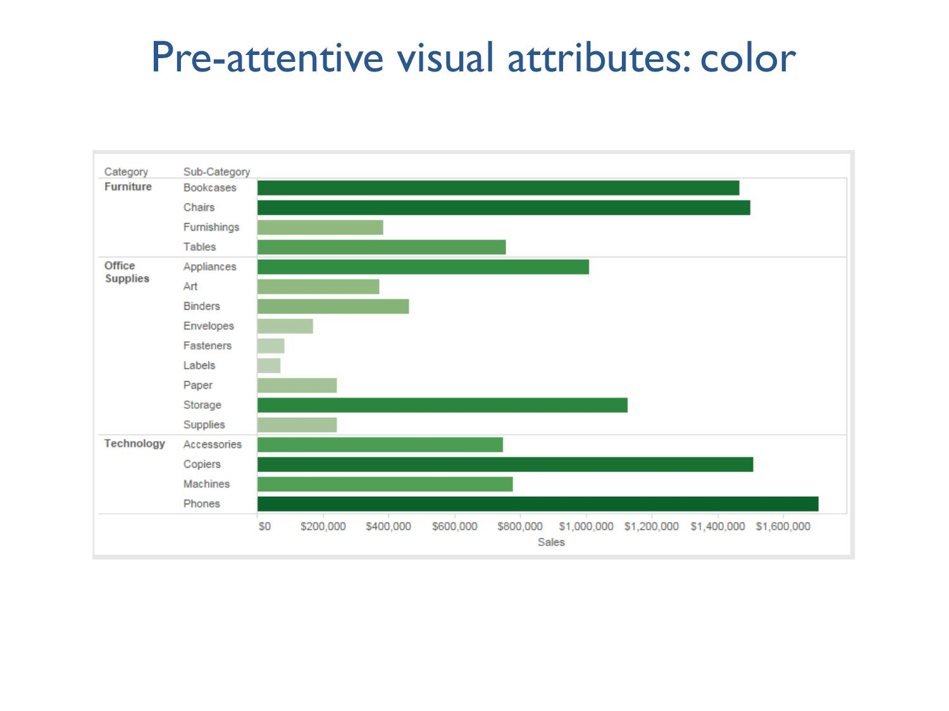
Notes:
Color is another example.
As I’m sure you experienced in these examples, pre-attentive processing is unconsciously done. We almost can’t help but assign meaning to our environment – and yet, we’re doing visual analysis!

Slide 36
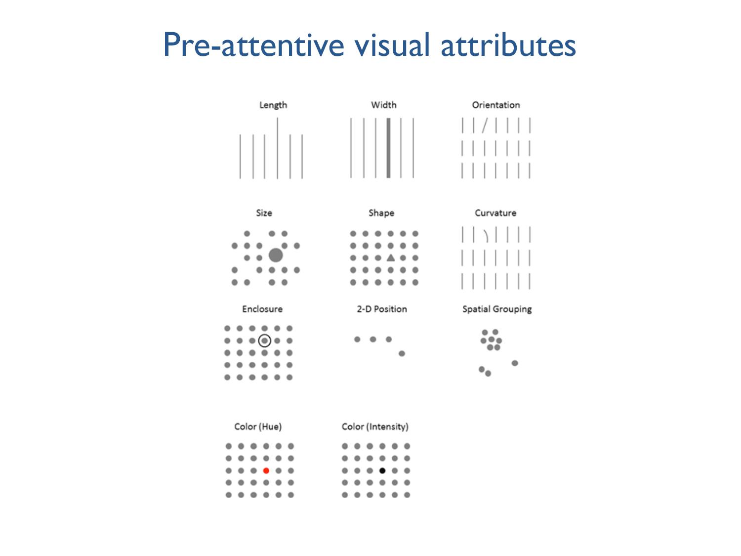
Notes:
As I’m sure you’ve guessed, using at least one pre-attentive visual attribute is the best way to present data, because we can see these patters – see what matters - and do some analysis without thinking too hard.
For a bit more about visual attributes I have a quick clip to show you, show this video: http://www.youtube.com/watch?feature=player_detailpage&v=wnvoZxe95bo
One important note, which we’ll come back to later, is that there is a difference between perception and sensation. In the past examples and on this slide, we can sensing and perceiving in the same way: I sense that the 4 bar to the left is longer than the other bars in the set and I perceive that that makes it noteworthy and something work paying attention to.
So, sensation is raw information and perception relates to our ability to stich what we sense together into something meaningful. Simple enough as a concept but we’ll explore how different sensing and perception can be – and the implications for data visualization – later on in this talk.

Slide 37
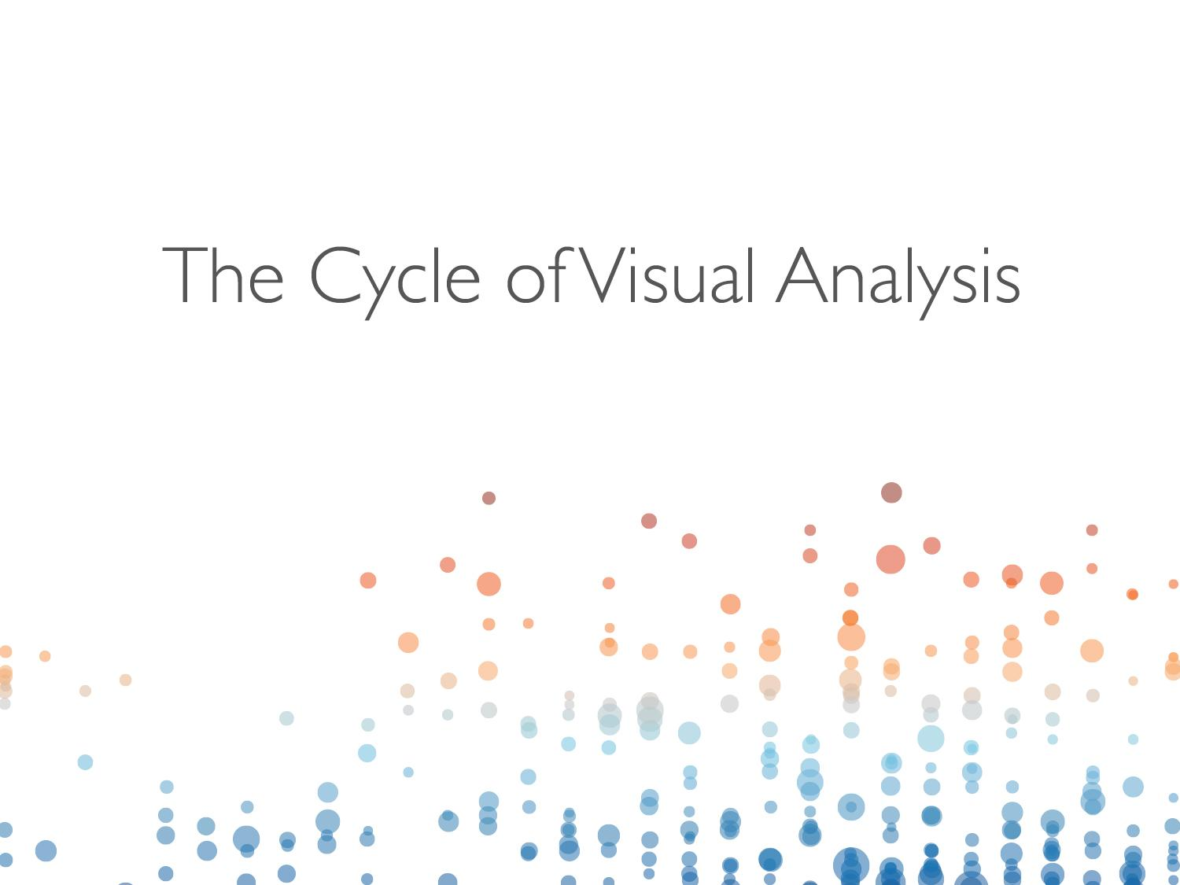
Notes:
Let’s jump back into how we analyze data visually…

Slide 38
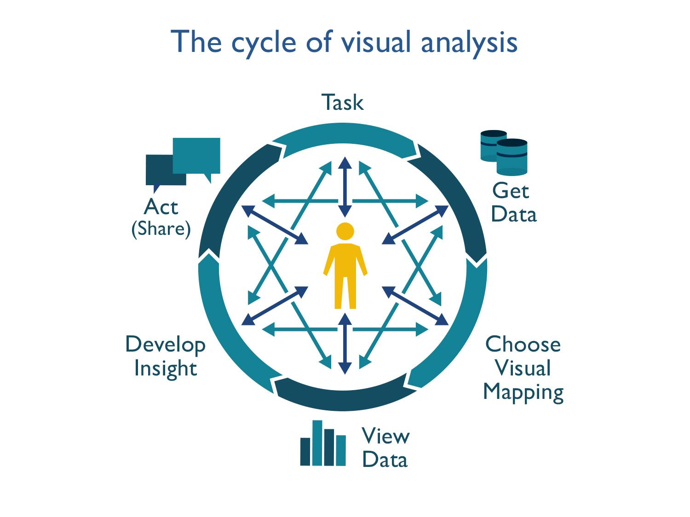
Notes:
Visual analysis isn’t just looking at a chart, or using colors – it’s an entire lifecycle that includes identifying and getting your data, establishing the structure of that data, choosing the best way to visualize that data, drawing conclusions or insight from those visualizations, and then getting buy-in around any conclusions supported by that data, which means you have to be able to tell a compelling story succinctly.
To help a team benefit from visual analysis, you need to support the whole cycle of visual analysis.
You get a task, sometimes simple, sometimes complex, the next step is to get the data and again, sometimes this is simple, sometimes this can be complex. Then you find structure in the data and only THEN do you get to viewing the data. And that has huge implications for how well you’re able to get insights – visual best practices! And then, if you are unable to share and act upon these insights then the cycle has failed you and it’s broken.

Slide 39
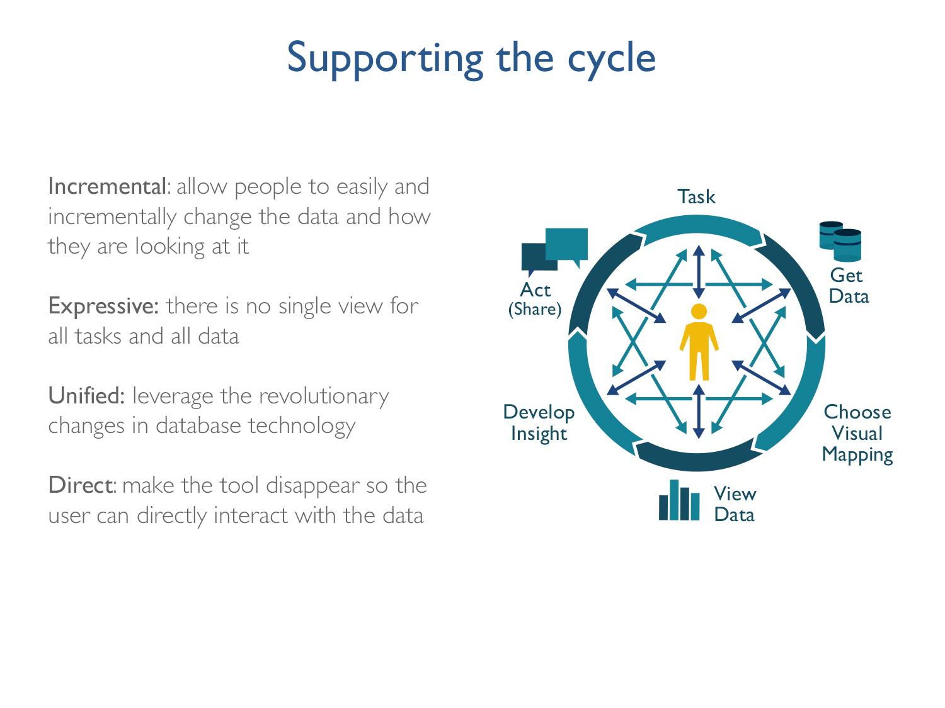
Notes:
We talked about pre-attentive visual attributes and how they can aid in analysis – but there are other ways we can strengthen the cycle of visual analysis.
Incremental – allow people to make small changes to the data to see how their changes affect their analysis
Expressive – there are usually several ways you can present data, which way leads to the best insights or deepest or easiest level of understanding?
Unified – just like human brain pulls from many different sources when learning and analyzing and forming conclusions, the cycle works best when you’re able to pull from several different data sources – such as US census data and municipality data and non-profit data.
It’s also important to note that the cycle isn’t one that can be uncurled to form a linear path. You want to play with data, test hypothesis, do easy comparisons, etc, so there are mini revolutions within each step of the cycle too.
Going through each step of the cycle is important so that the actions on the left – 8 and 10 o’clock are meaningful and continue to drive the cycle forward.

Slide 40


Slide 41
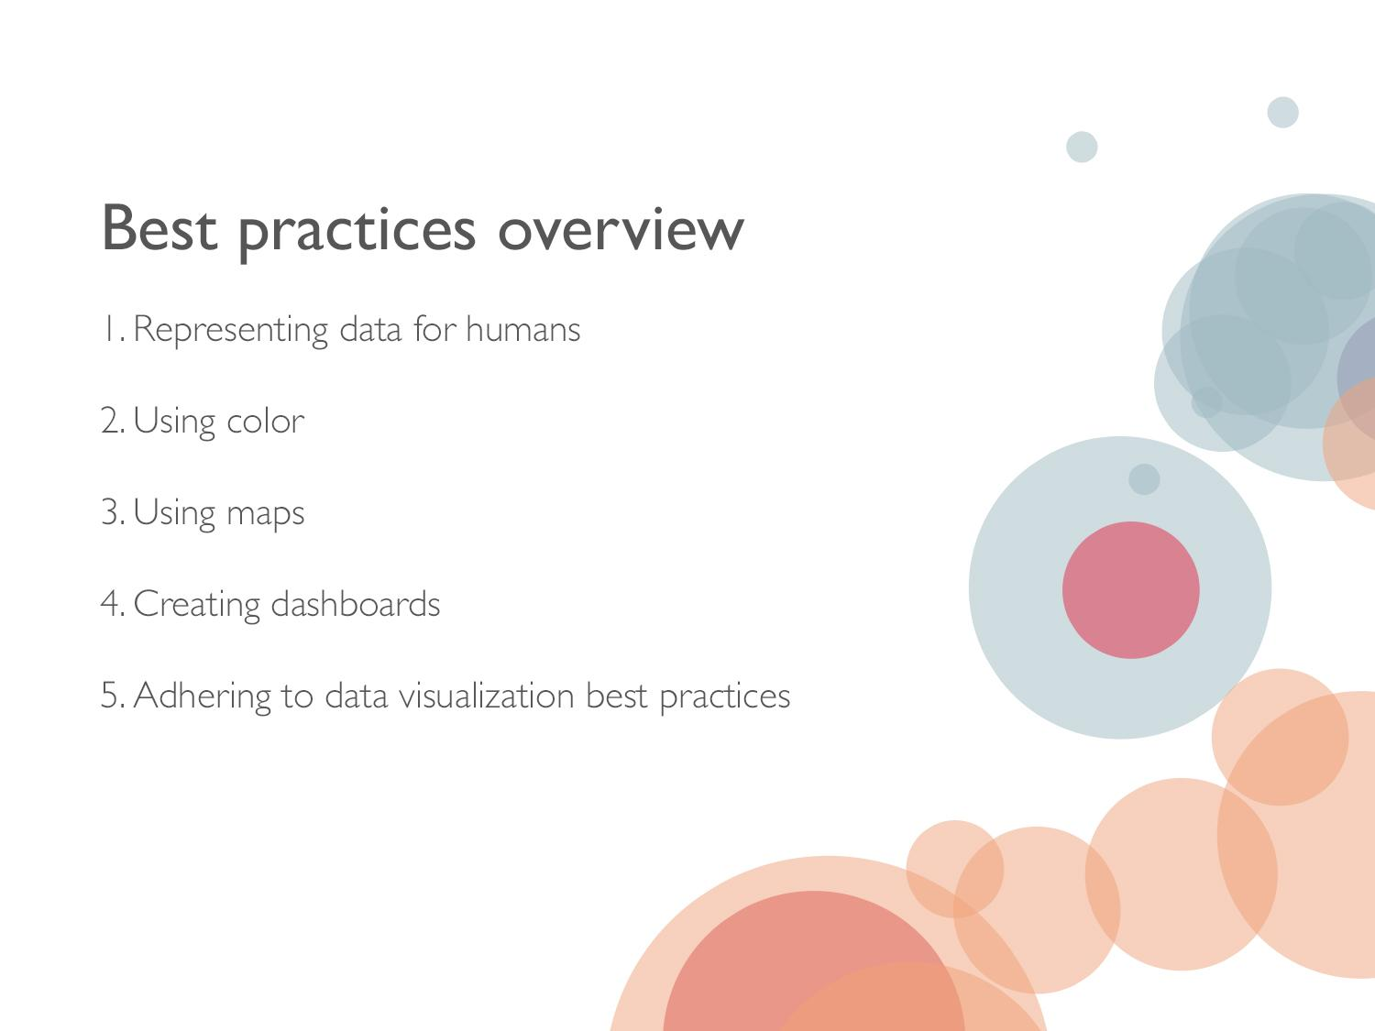
Notes:
Today we’re going to talk about…
#5: in Tableau we call this the viz or view…

Slide 42
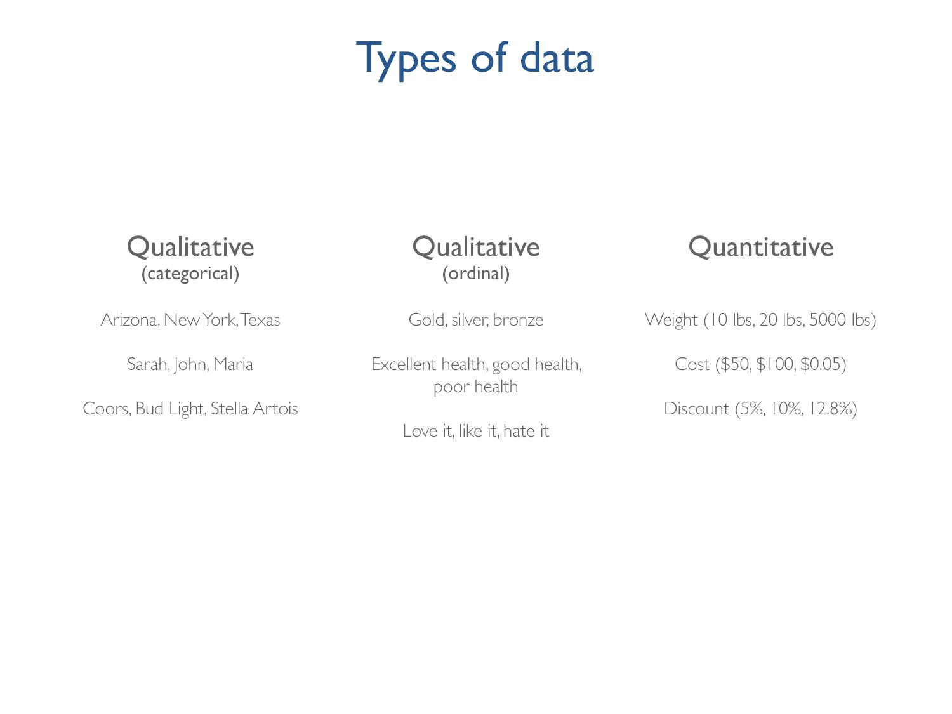
Notes:
Let’s start talking about the different types of data. There are three key types of data.
Qualitative, nominal – there is no clear order to the data and they don’t have a clear relationship to each other, they don’t contain numbers
Qualitative, ordinal – the have a relationship to each other but you can’t measure the distance between them but you understand how the compare in relationship to one another
Quantitative – these data are numbers, you can do math with them, and you know exactly what the difference between them is (their relationship to one anther – the difference between 5% and 10%)
Basically, the type of data you have impacts the ways in which you can visually represent it.

Slide 43
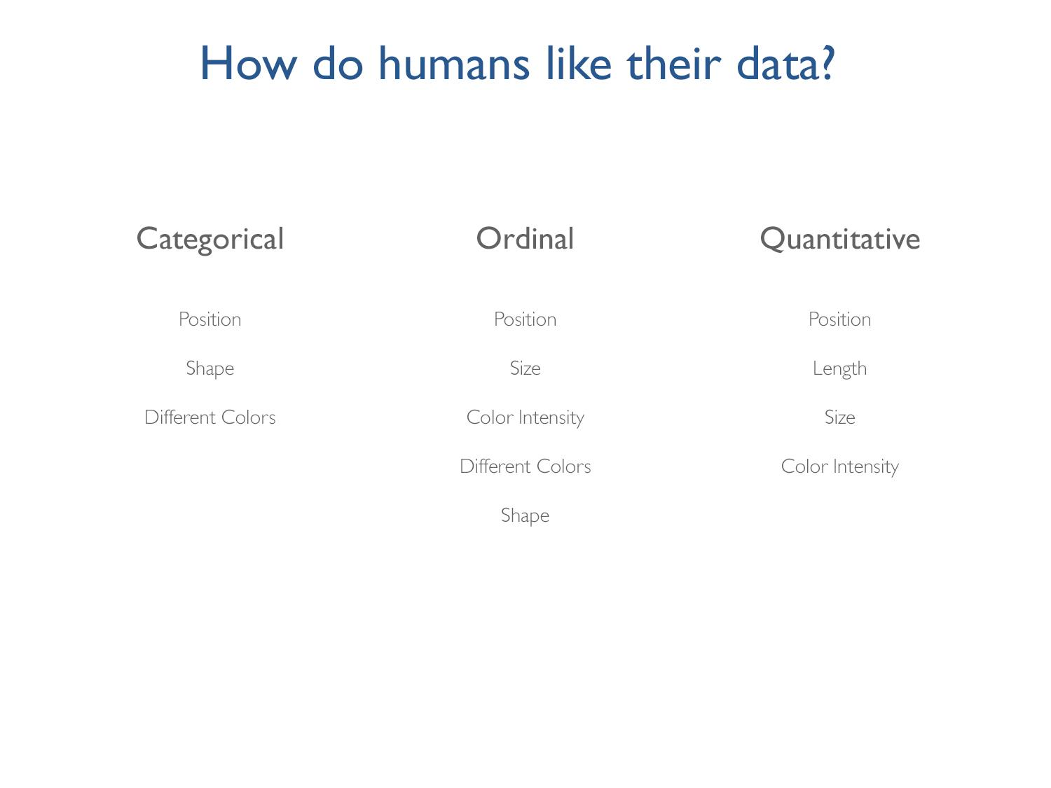
Notes:
Position is the best way across these 3 types of data.
This shouldn’t be surprising to any of us – especially when represented as a generality, rather than by data type…

Slide 44
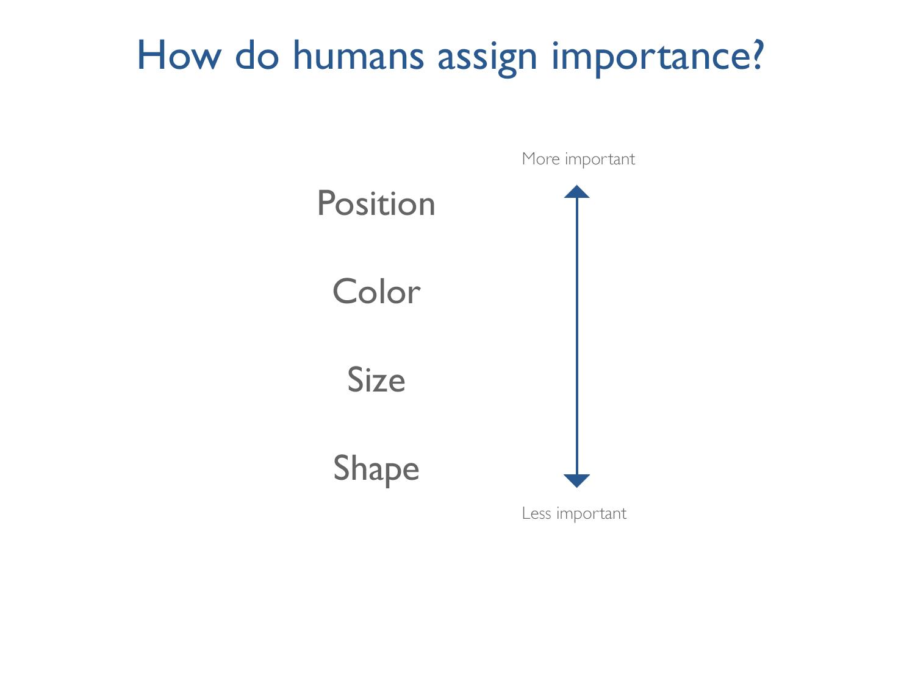
Notes:
Humans view position as the most important data point and shape as the least important. This is how the human brain naturally assigns importance to data.
This hierarchy makes sense – for example, can you imagine how confusing it would be if stop signs were yellow and yield signs were red.
In fact, the reason why this is confusing is because there is a disconnect, in that example, between what we’re sensing – intuitively we know that red is more important than yellow – and what we’re perceiving – all drivers know that stopping is more important than yielding.
Because it happens at the subconscious level, it can be pretty easy to trick our brains into thinking that what they are sensing is also what we’re truly experiencing. And that can seriously cloud our perceptions. Show Darren Brown video.
So, now that you’ve seen how hard it can blend sensing and perceiving, let’s try it ourselves…

Slide 45
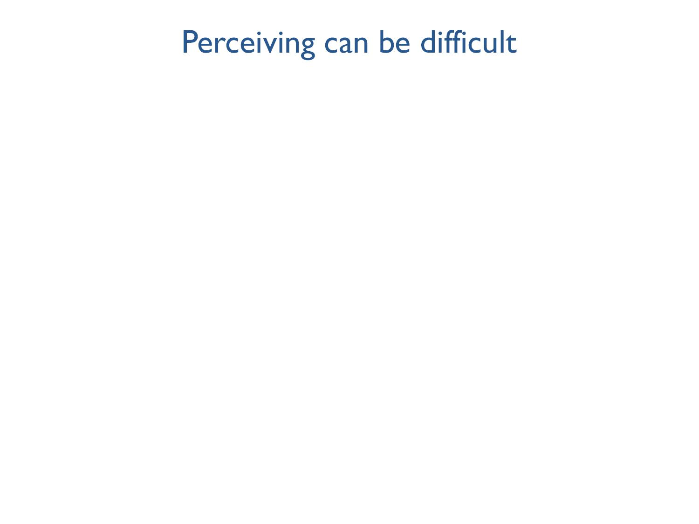
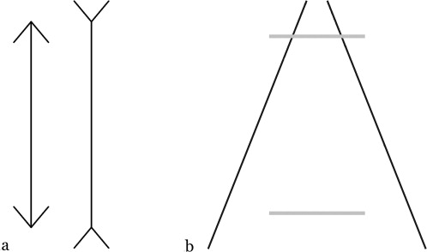
Notes:
I’m going to show a video where there is a short visual interruption – a millisecond of blankness between 2 images that identical except for one difference. Can you perceive the difference?

Slide 46
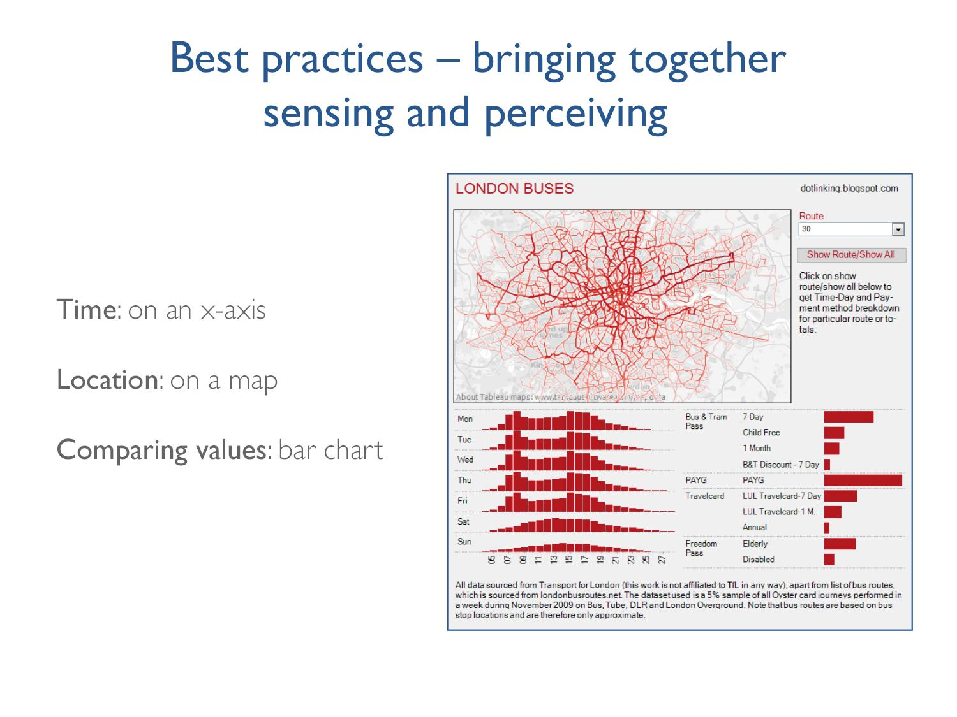
Notes:
In addition to an understanding of our hardwired pre-attentive visual attributes and the way we assign importance, being sensitive to other sensing pitfalls – like the difficulty visual interruption presents – is important.
So too are standards – time on the x-axis, location on a map, a using a bar char to compare values.
In this dashboard it’s easy to understand the area (size/scope) of the data, the time frame (day of the week, the work day) and what we’re comparing (different ticket types)
The red makes the data pop but it’s not overly complicated with different colors that would only confuse the viz – for example, marking the days of the week in in alternate colors would be meaningless here.

Slide 47
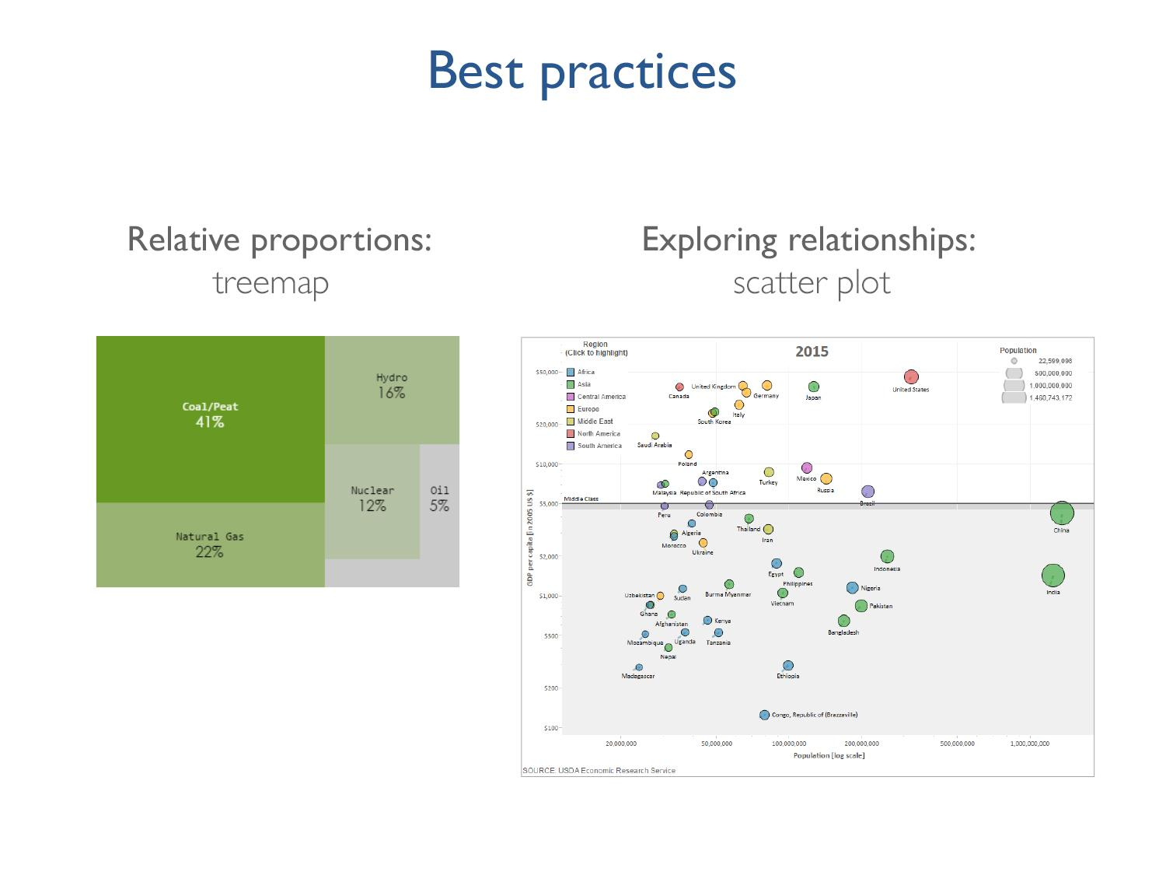
Notes:
Not captured on the dashboards were 2 other common visualization chart types:
Relative proportions, proportions of the whole = tree maps
Relationships between data = scatter plot

Slide 48
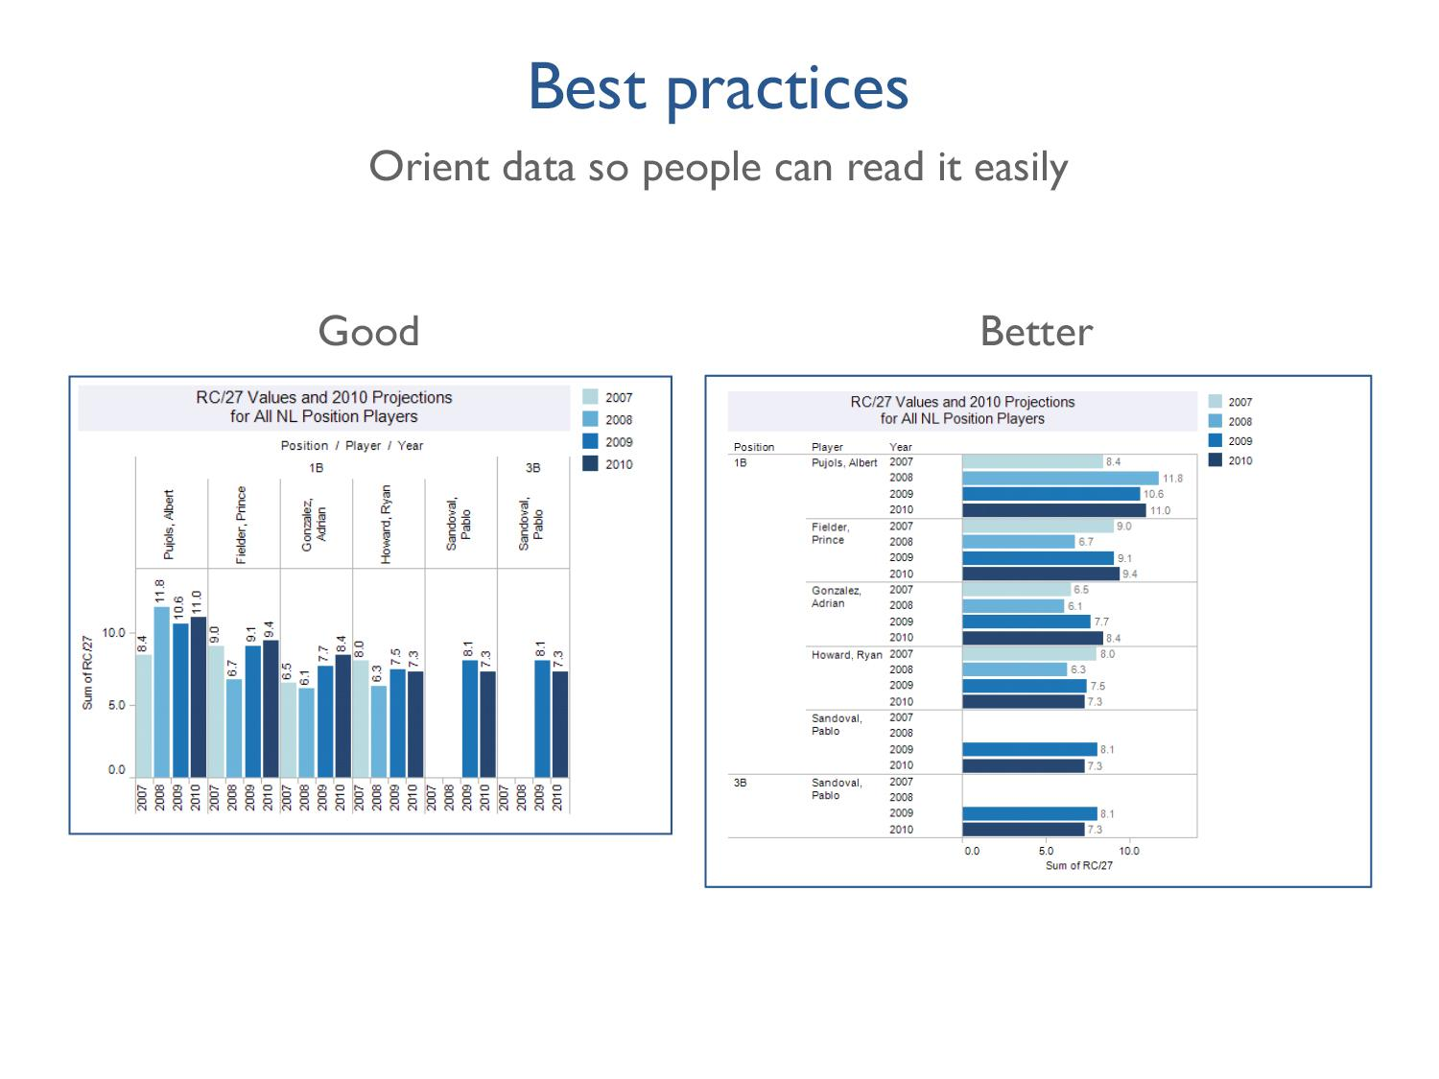
Notes:
Orient data so people can read it easily. You read English from left to right so as much as possible, we want our data to go left to right.
How many of you have the urge to tilt your head to make the chart on the left easier to read? Don’t make your audience to that! Tilt it for them ☺

Slide 49
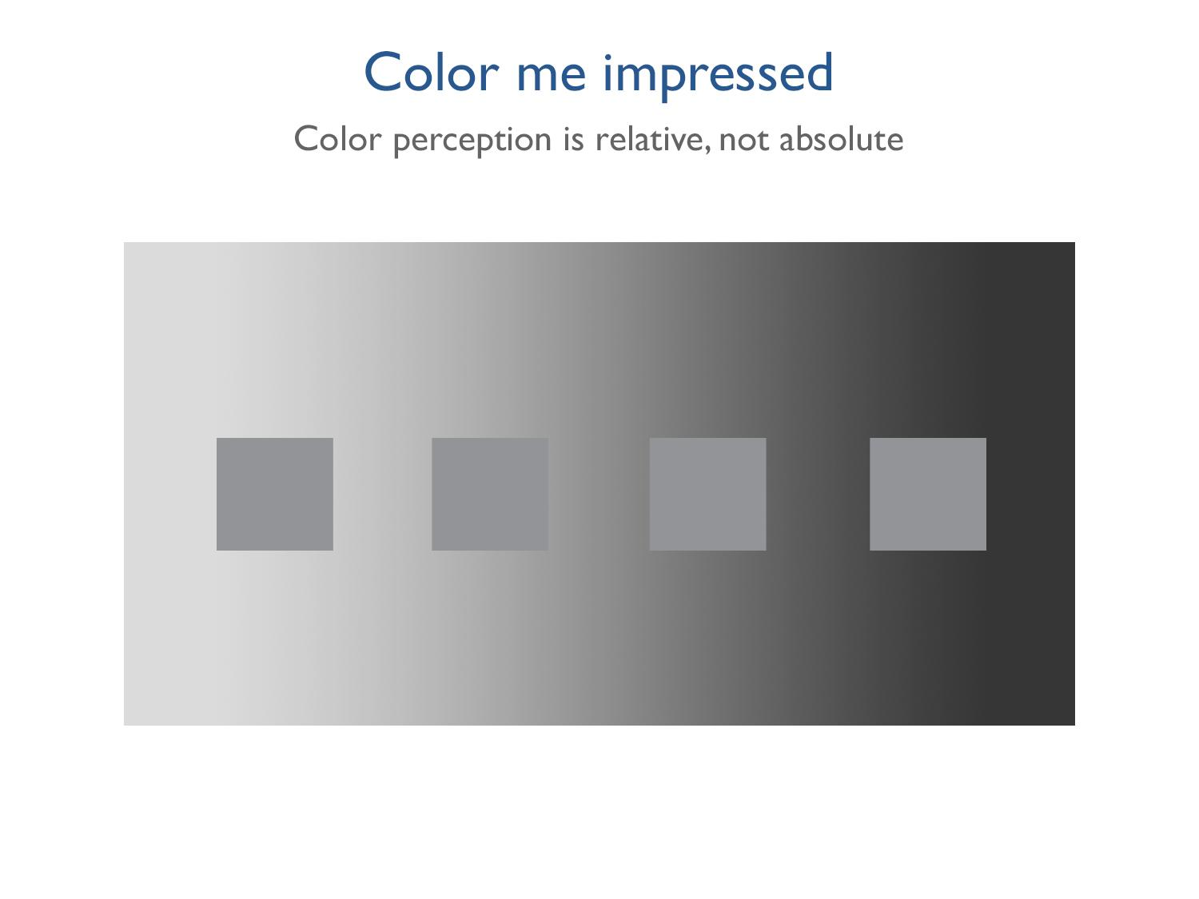
Notes:
Color is relative, not absolute.
Which of these squares is lightest? If we’re trying to encode meaning into color, we have to pay attention to how the viewer will perceive that color in context

Slide 50

Notes:
They’re all the same color but we didn’t know that until we had a consistent background – what are the implications for your data visualization best practices?
When using color – provide your users with a consistent background so they can determine differences and non-differences. Knowing they’ll sense a difference, help them to only perceive it if it’s actually there.
You don’t want to have the color version of Anscombe’s Quartet – it’s not enough to just use color, be mindful of visual best practices to make the story accurate.

Slide 51
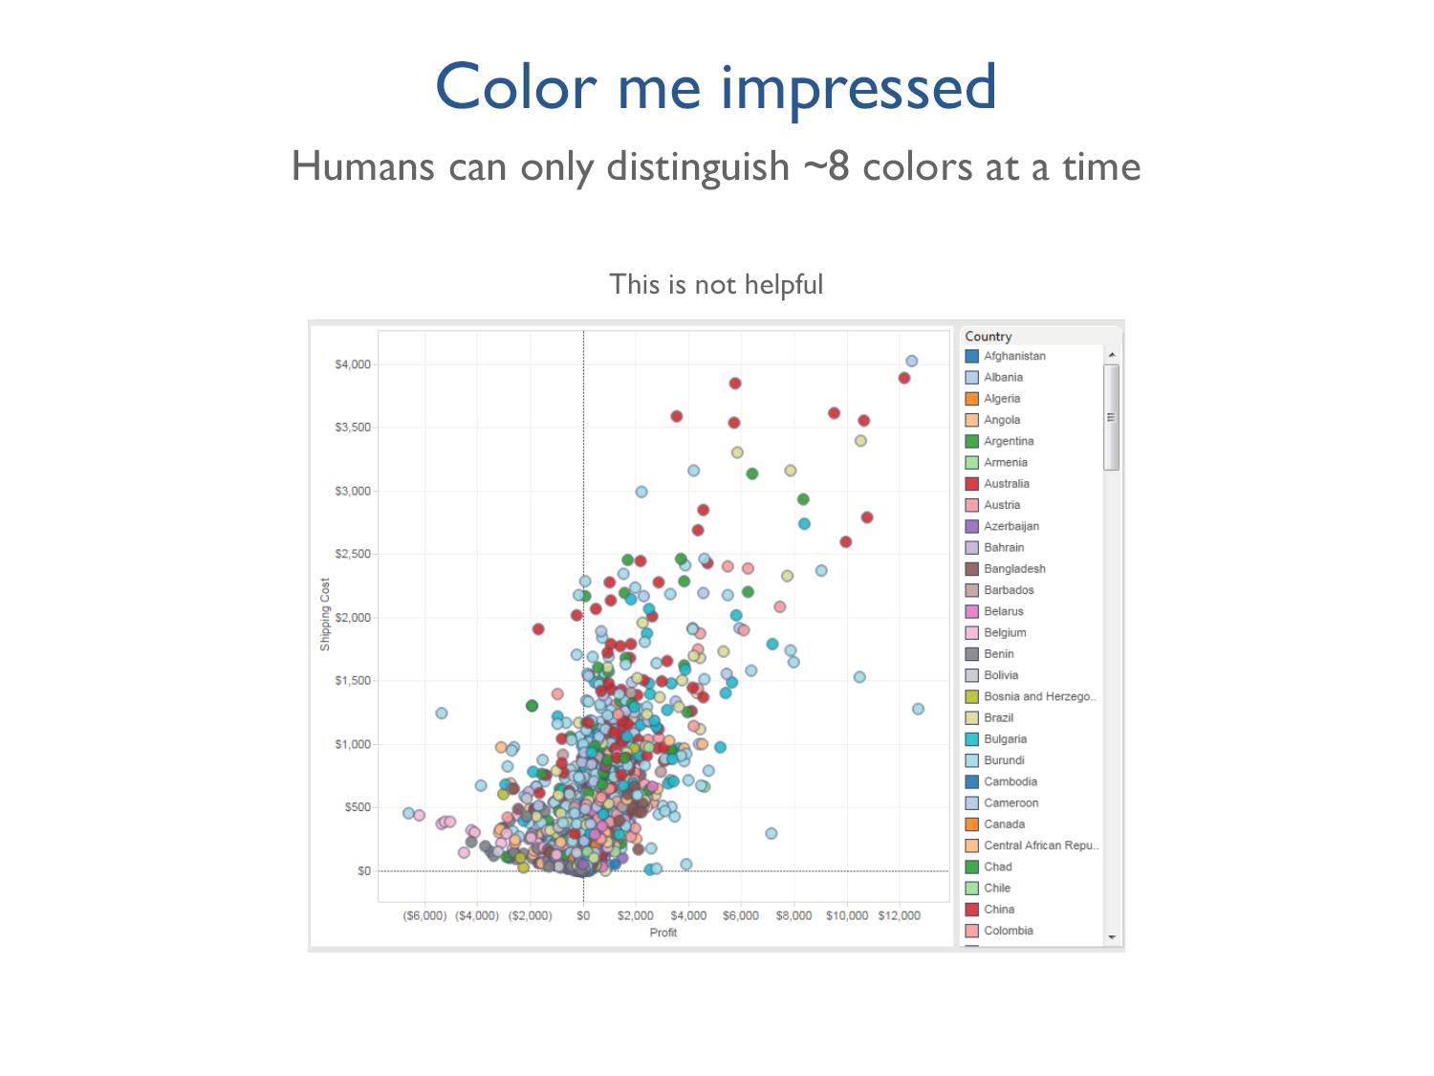
Notes:
This is a mistake that is pretty common. You have about 150 different data points and you’re mapping them to color but this is bad because I can’t tell if the blue is Albania or Cameroon

Slide 52
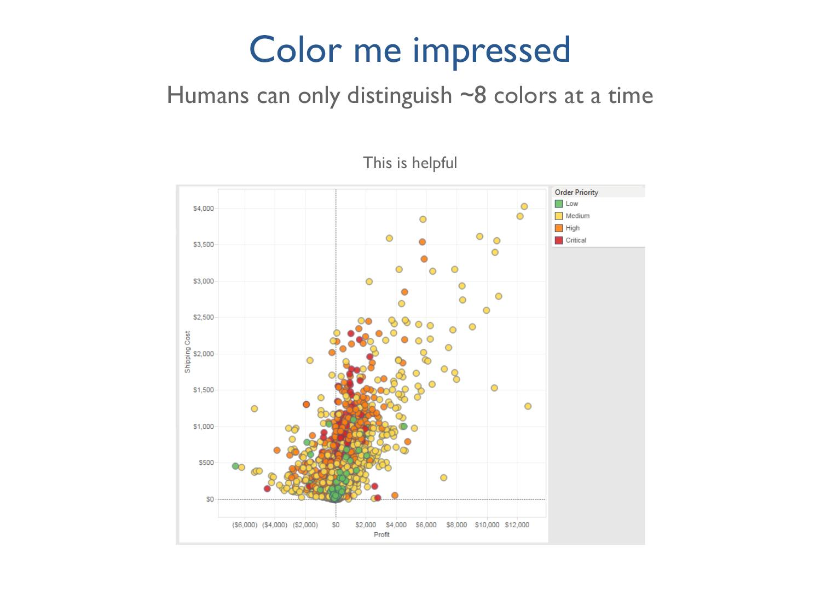
Notes:
This is much better – you have there are limited options for color, and they correspond with the order priority. I can see that we don't have any low priority orders with a high shipping cost, which is good, and that most of the high profit orders are medium priority – not high or critical. I know what happening because my brain isn’t overwhelmed with trying to distinguish color and so can easily see patterns.
If you remember the funnel of characteristic importance, position was before color and in this viz, unlike the last one, color helps support our brains’ desire to make sense out of the data positions.

Slide 53
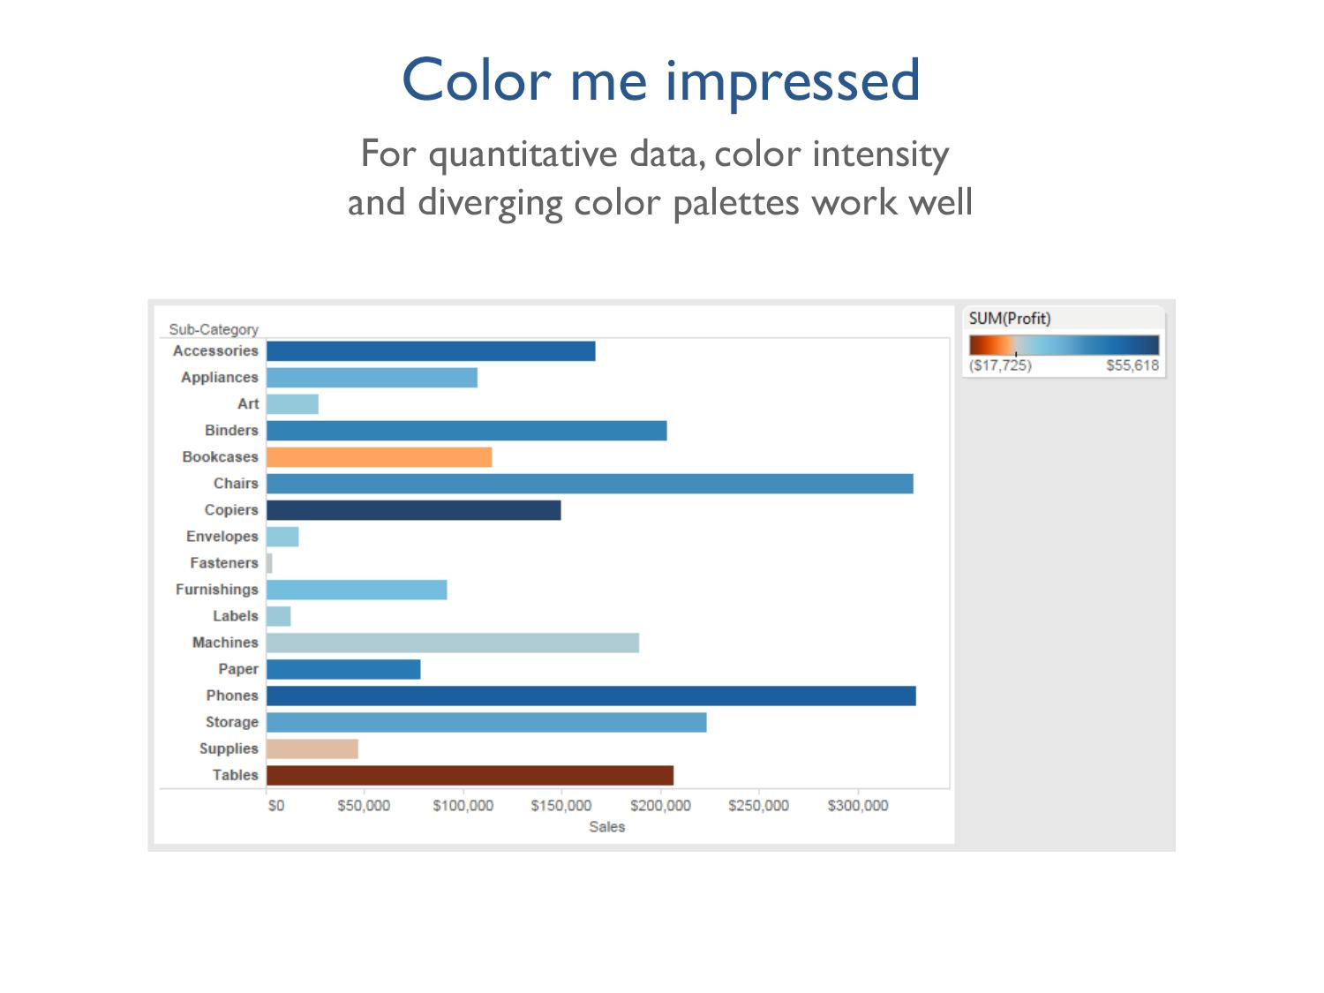
Notes:
When you’re working with quantitative data these two practices work really well. Negative profit as orange and positive profit as blue – red and green are more traditional, but this is color-blind friendly. If I had this bar chart without the colors, I might think that appliances, bookcases, and copiers were all performing about the same for us because their sales are roughly equal.
But when I add profit to color on this bar chart it’s immediately obvious that bookcases are actually losing money for us, as are supplies and tables

Slide 54
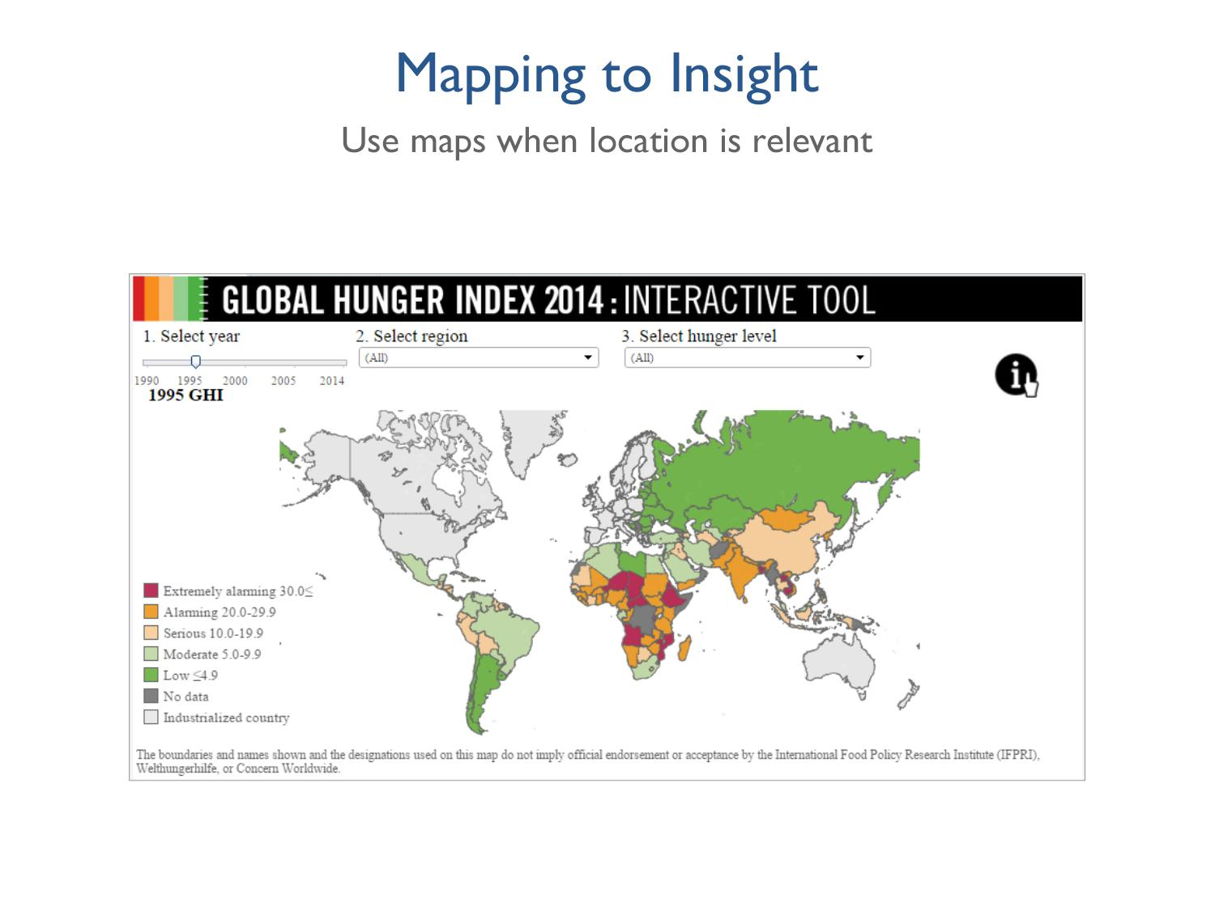
Notes:
When it matters where things are – this is not always the case!
You don’t want to use maps just because you can.
Here, the map helps us pick out trends – as does the color!

Slide 55
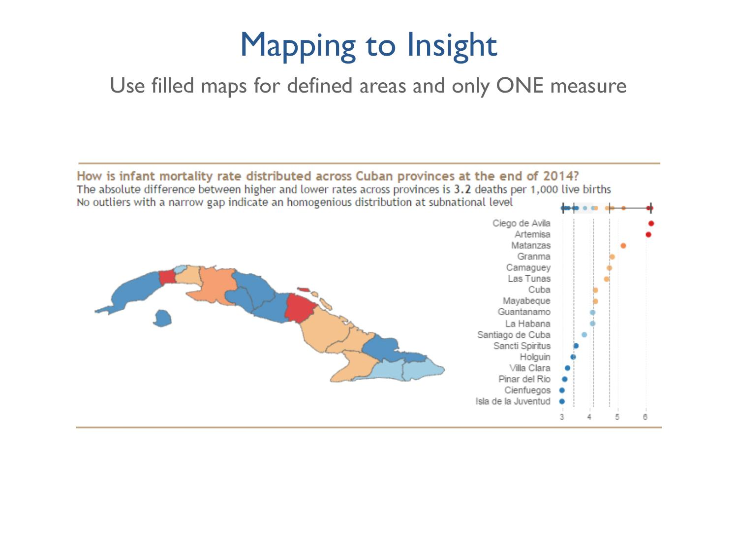
Notes:
Filled maps work well when you have defined areas like states or cities and only one measure.
For this map, we are looking at infant mortality across Cuban provinces – see can see that there are two pockets of 4-6 deaths per 1,000 live births

Slide 56
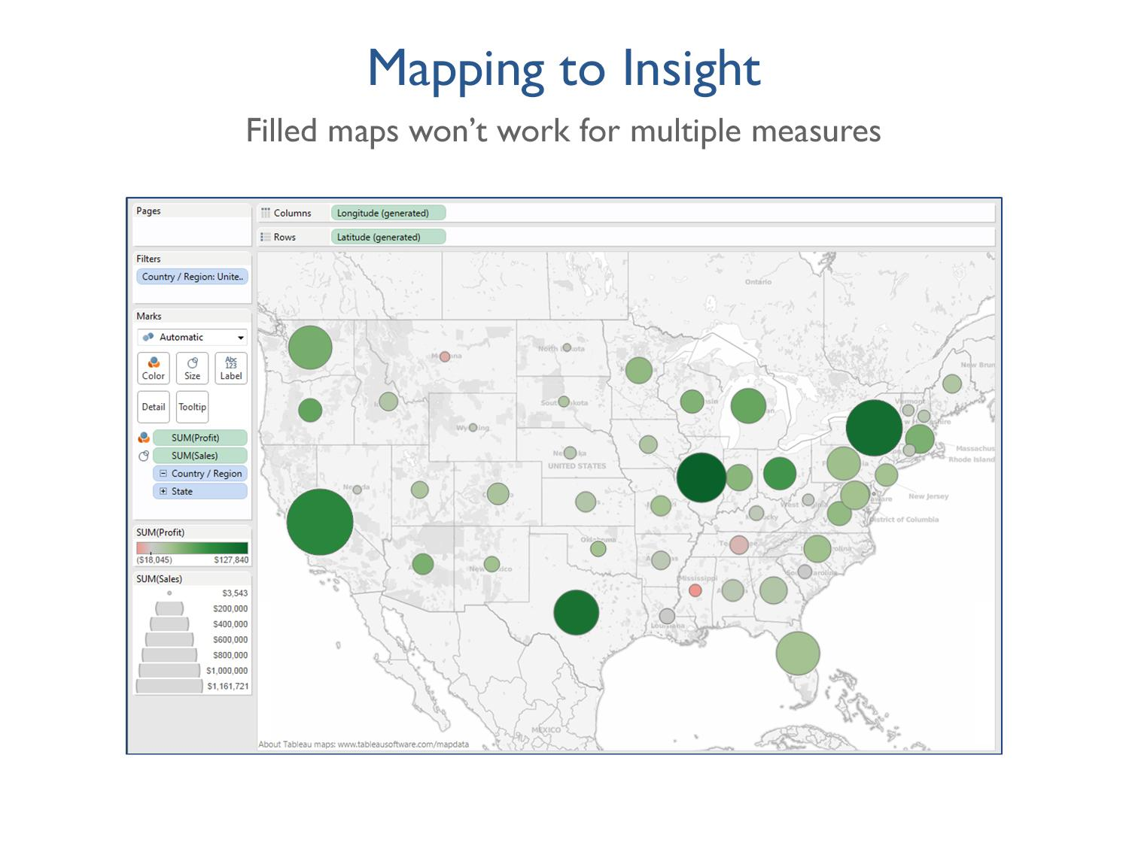
Notes:
As soon as you pull in a second measure, say sales, filled maps don’t work.
We still have a map here but with profit on color and sum of sales on size, we are unable to use a filled map.
How is using a map more useful here than a bar chart? Answer – looking at regional differences – we’re doing pretty well on the Eastern seaboard but not so hot in the Midwest, for example.

Slide 57
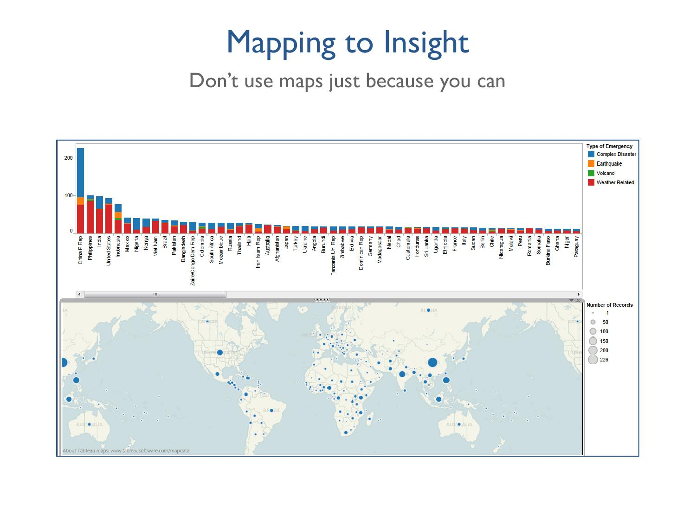
Notes:
Knowing where on the globe each of the courtiers represented in the bar chart doesn’t add to our analysis.

Slide 58
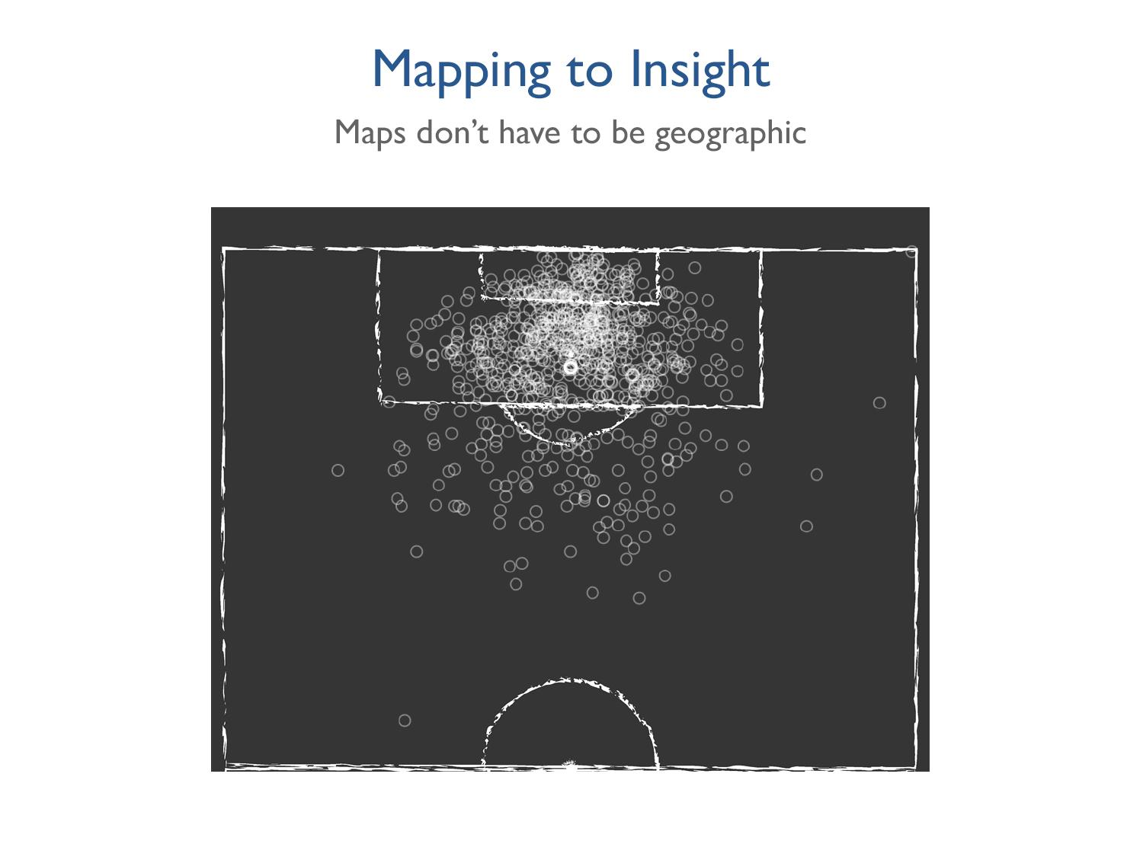
Notes:
There are a lot of creative uses for maps, especially non-geographic maps – like here, showing where shots were made on a basketball court

Slide 59
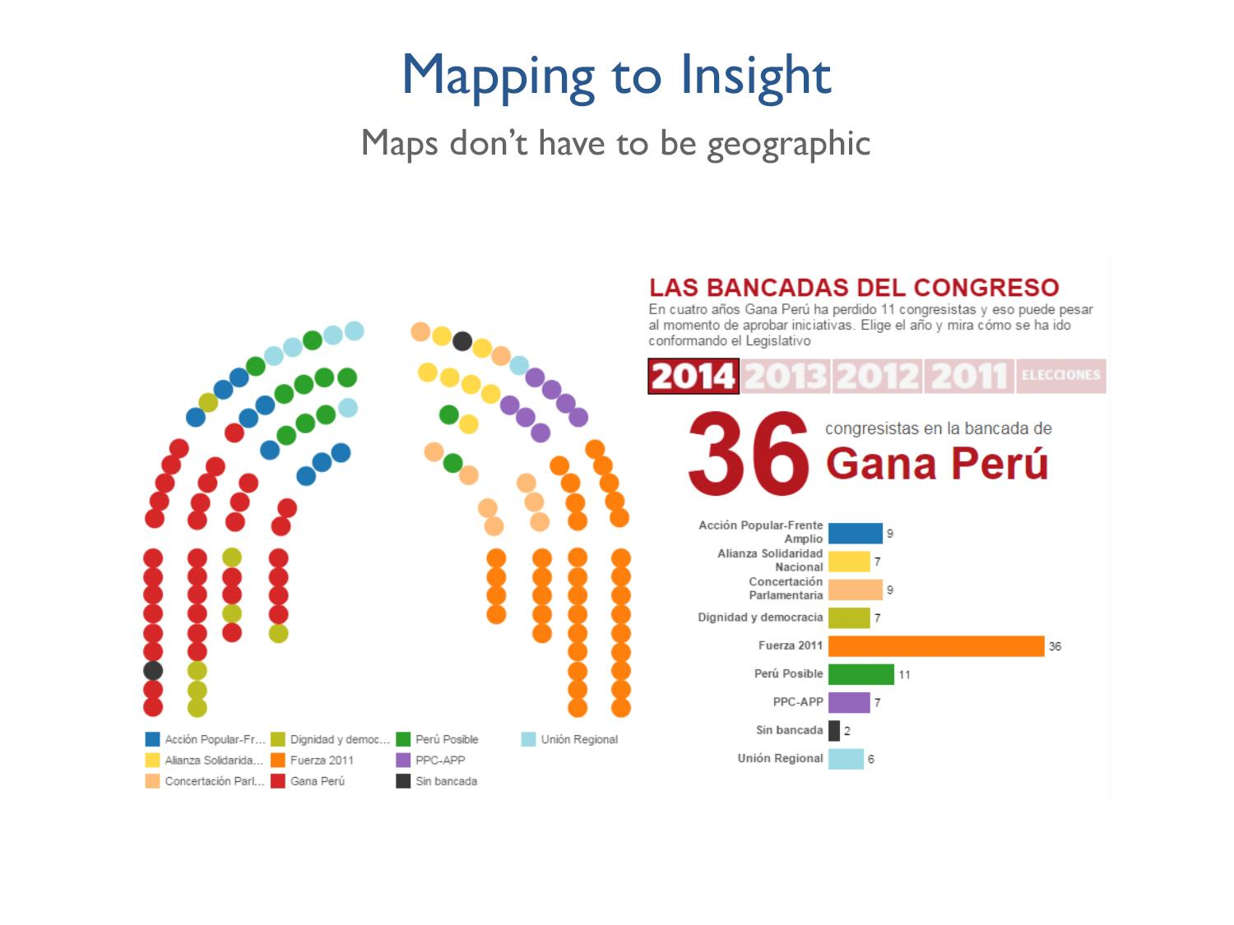
Notes:
Another easy to understand example is seating for large venues like stadiums or concert halls, or congressional seats

Slide 60
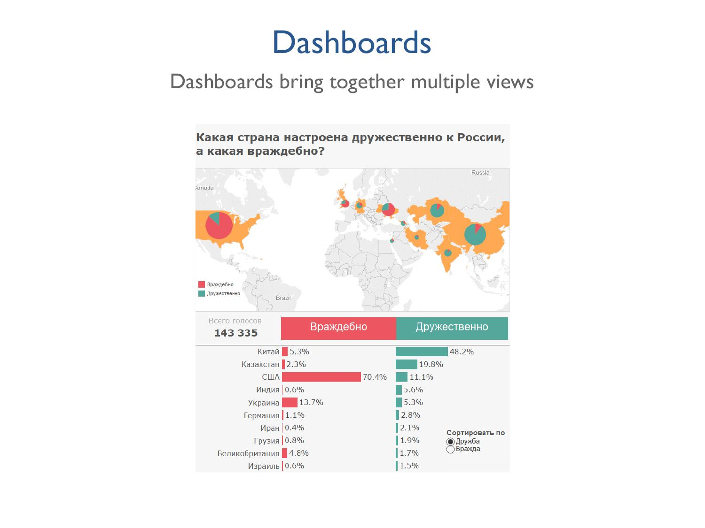
Notes:
What insights can you get from this dashboard?
Well, it’s in Russian, but you get the idea – the information encoded spatially on the map is broken down in greater depth below, as we can see by the color scheme between the pie chart and the bar chart.
Even without understanding the words, we can perform some basic analysis – for example, we can easily see that the pattern in the US is the reverse of China by the wedges of red vs green.

Slide 61
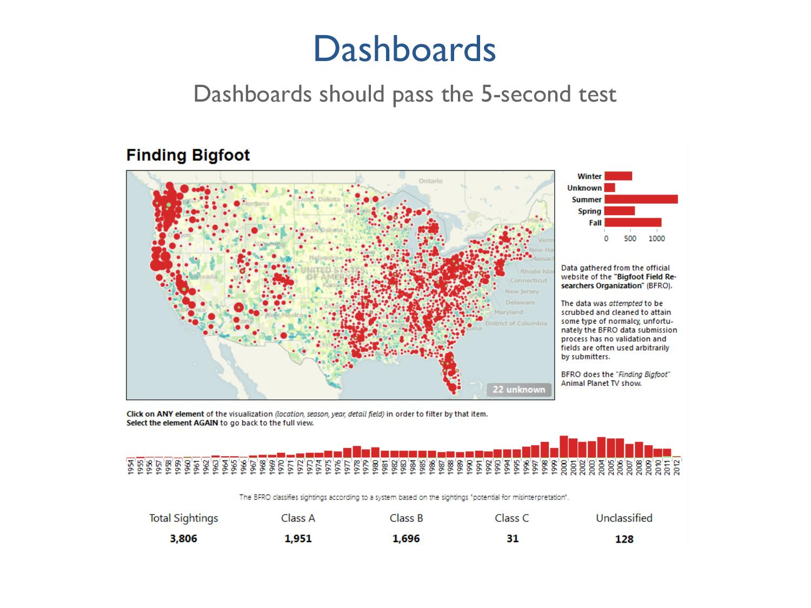
Notes:
What do you think the 5 second test is?
The goal is that you should know what is going on in the dashboard in 5 seconds.
This one is good b/c you know exactly what it is – good title, clear why map was used.

Slide 62
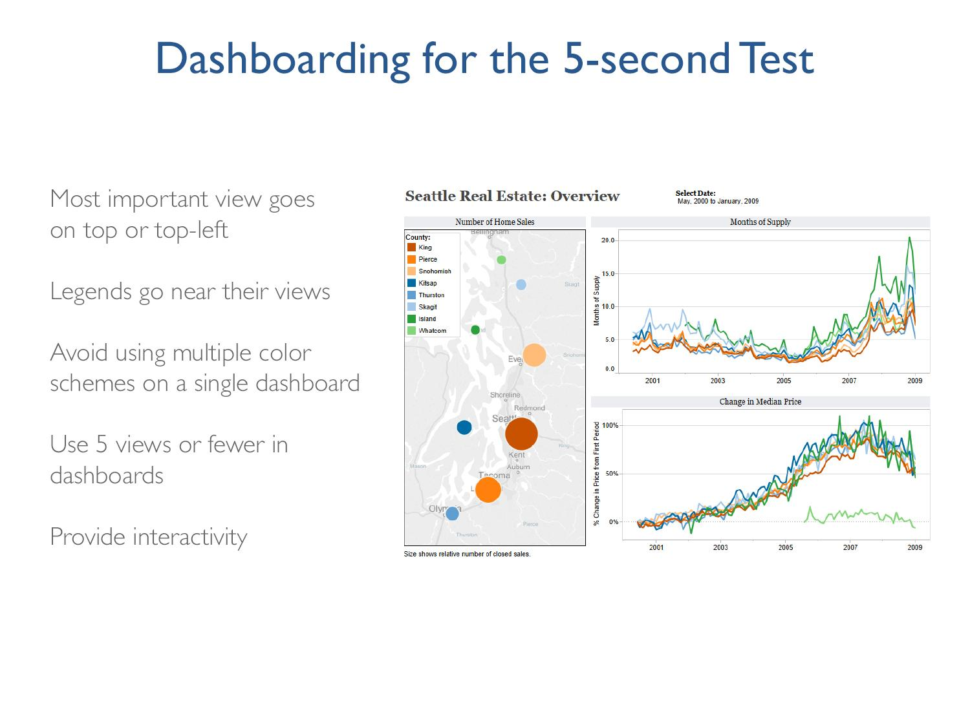
Notes:
And have a good title, too!
There are exceptions for this – some executive dashboards have 20 or so views but that’s the exception, not the norm!
Missing the “Use your words” slide!!!

Slide 63
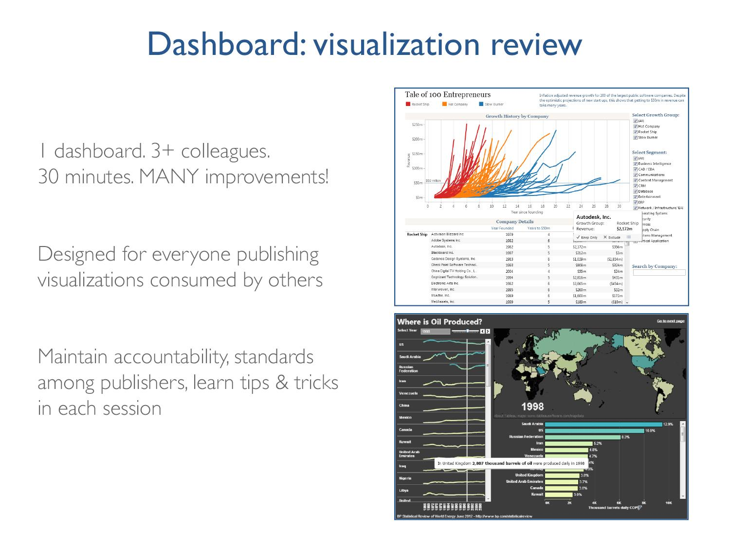
Notes:
After creating something you are ready to publish, invite 3 or more colleagues to a 30 minute meeting and show them your visualization. Now you’ll hand over the mouse and let them click through everything, come up with potential issues and uncover broken parts. A viz review is the same concept behind software engineers holding a code review or an author using an editor before publishing his novel.
EVERYONE who publishes an externally-facing visualization should conduct a viz review. Anyone publishing an externally-consumed viz goes through this process.
This is important for a few reasons – it maintains accountability and ensures that the finished viz product has been reviewed. The collaborative aspect of a viz review is also a valuable piece - each person in the viz review leaves smarter with new knowledge just by hearing what others have contributed.

Slide 64
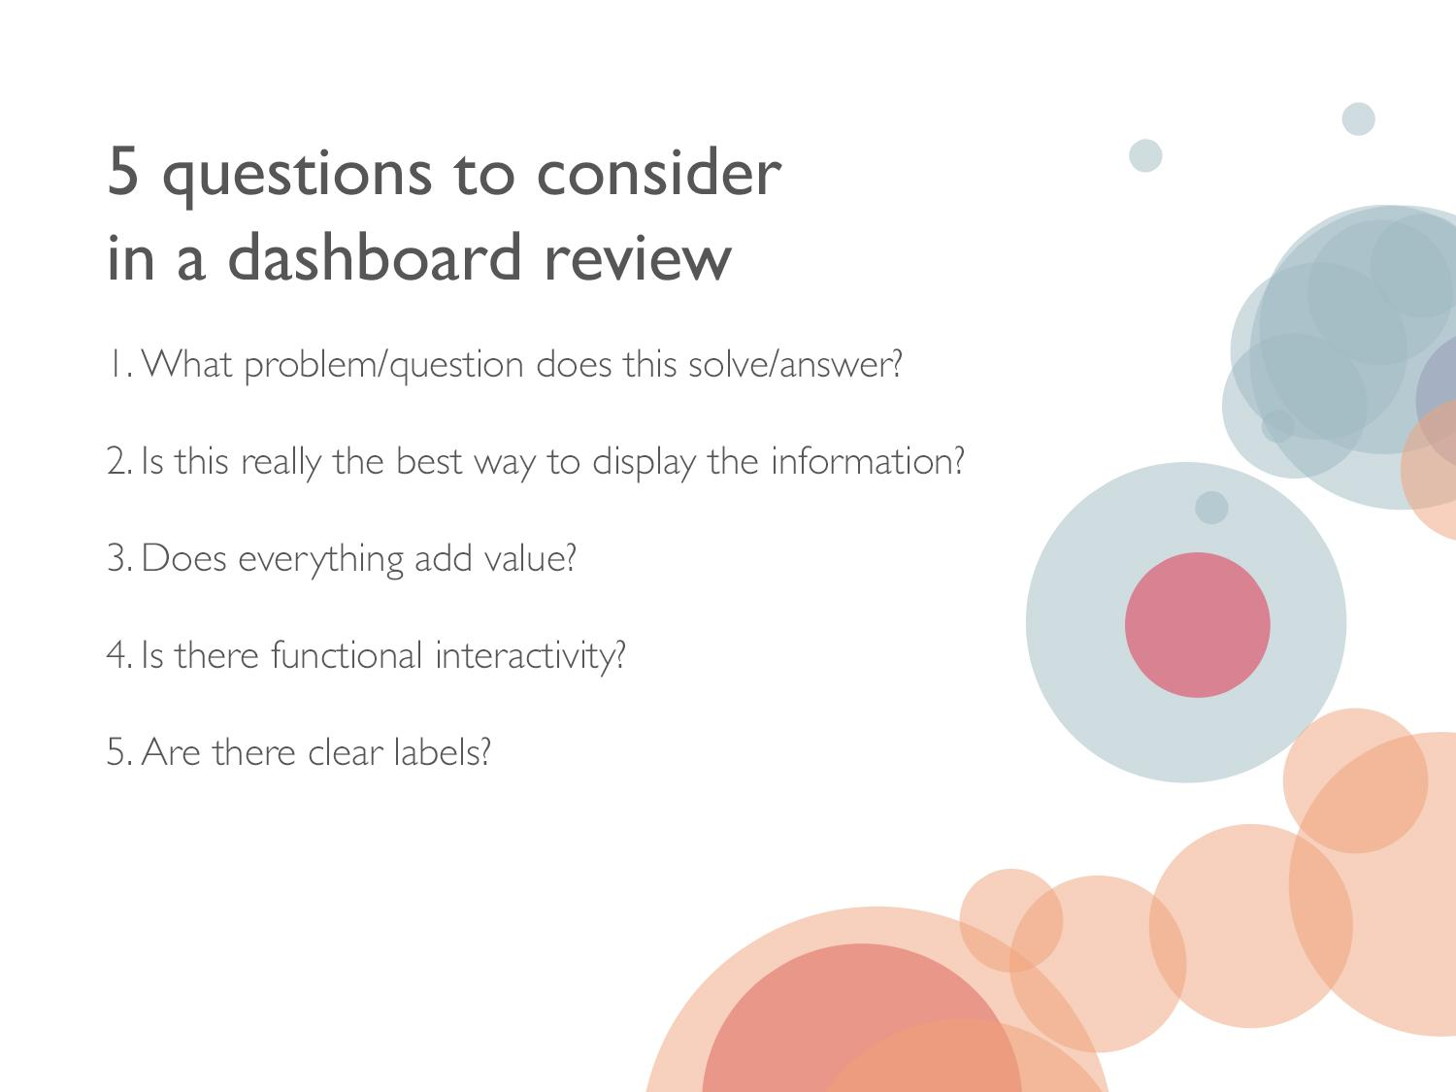
Notes:
Based on the 5 second dashboard test, the purpose of the dashboard should be immediately clear. What problem does this solve OR what question does it answer? Is this immediately clear?
2. Have you used the space effectively? Is there a better way to display the data?
3. Don’t add things just because you can. Make sure everything on the viz is useful and valuable to the end user. Oftentimes the simplest vizes tell the most compelling story.
4. Have you utilized filters, highlights and other actions to provide interactivity to the end user? Now go through each of these and make sure it displays as you would expect – be sure to check various scenarios and edge cases.
5. Make sure to include a color legend, labeled X & Y axes, as well as sheet names, if needed.

Slide 65
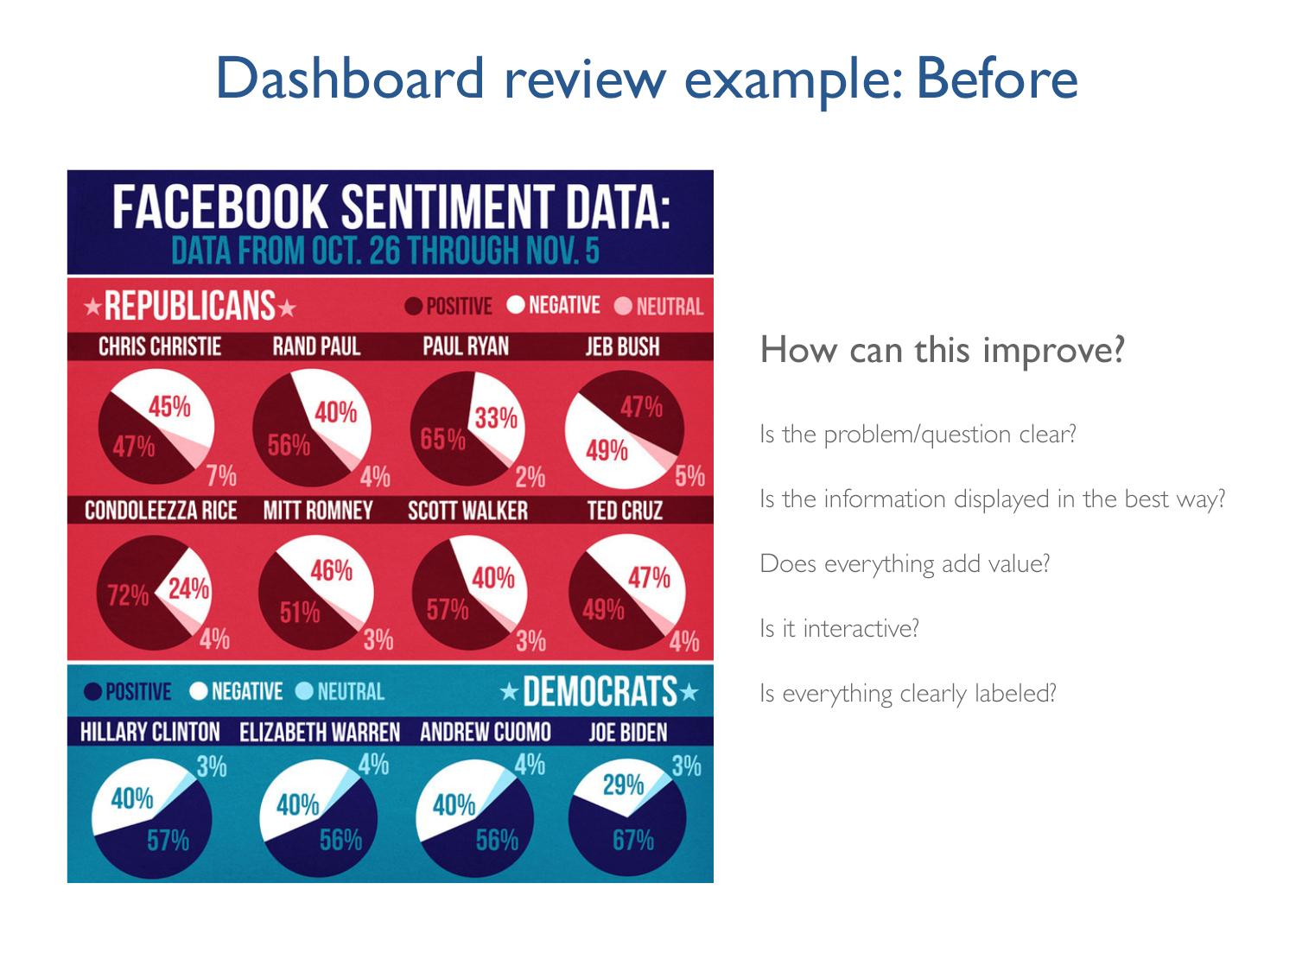
Notes:
Draw on the 5 questions from the viz review:
What question does this answer? In this case, the question is “how do Facebook users see 2016 political candidates”
Is the information displayed in the best way?
Pie charts are hard to compare, no sorting of the individual candidates
Second row of red labels could be ambiguous
Does everything add value? Alternating the republicans and democrats titles and color schemes doesn’t help
Functional interactivity? no
Clear labels? Unclear title, All caps are hard to read

Slide 66
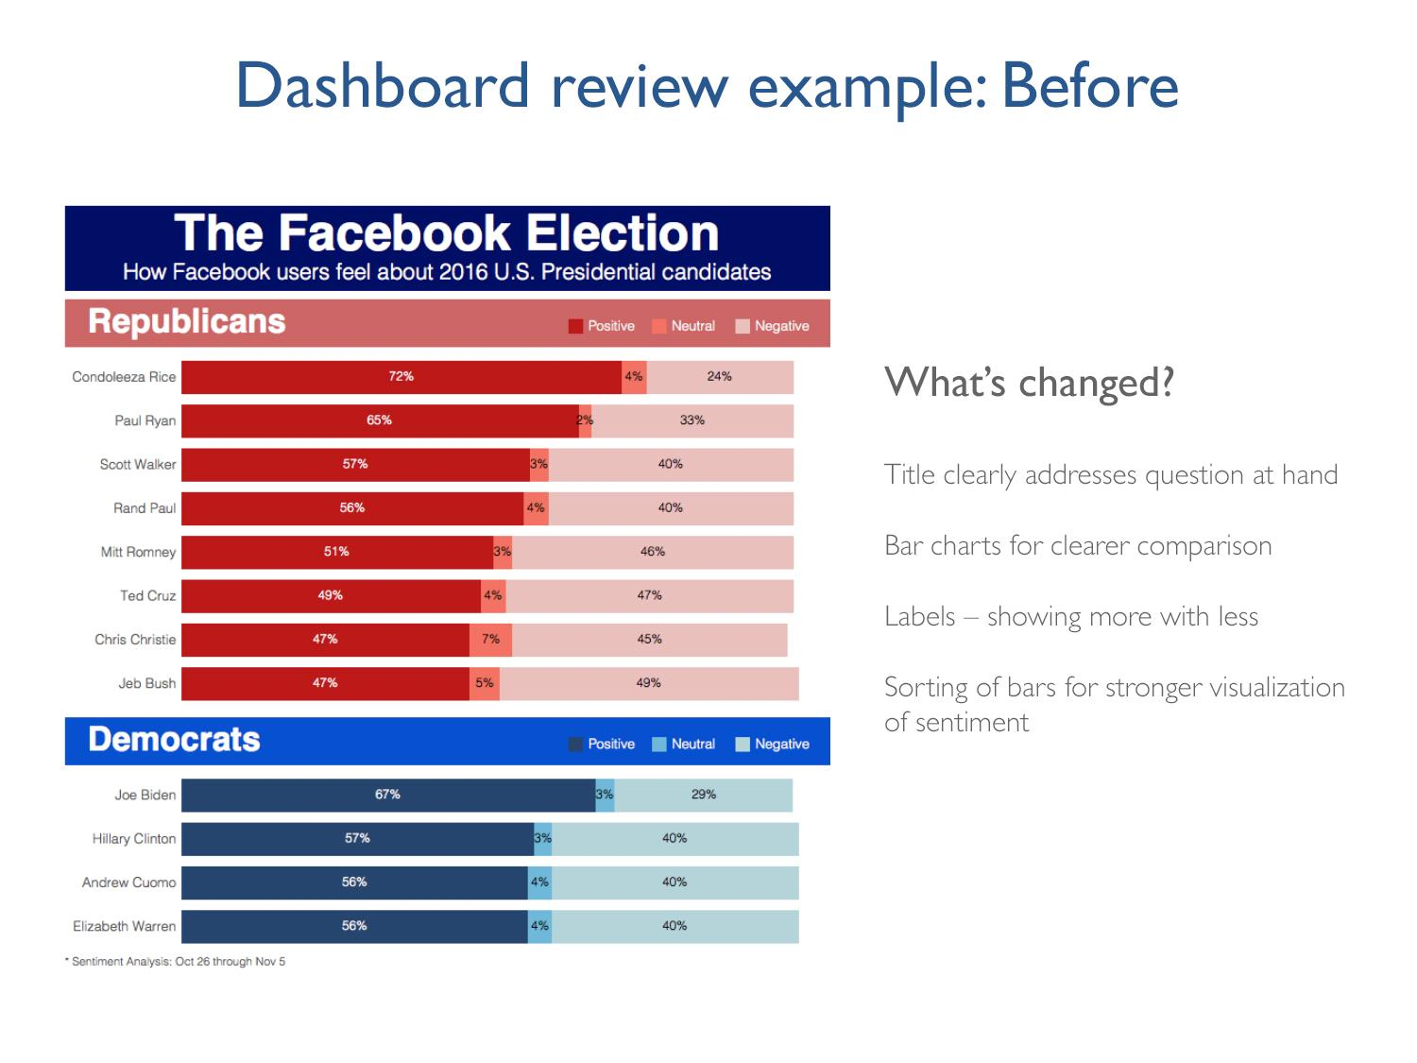

Slide 67
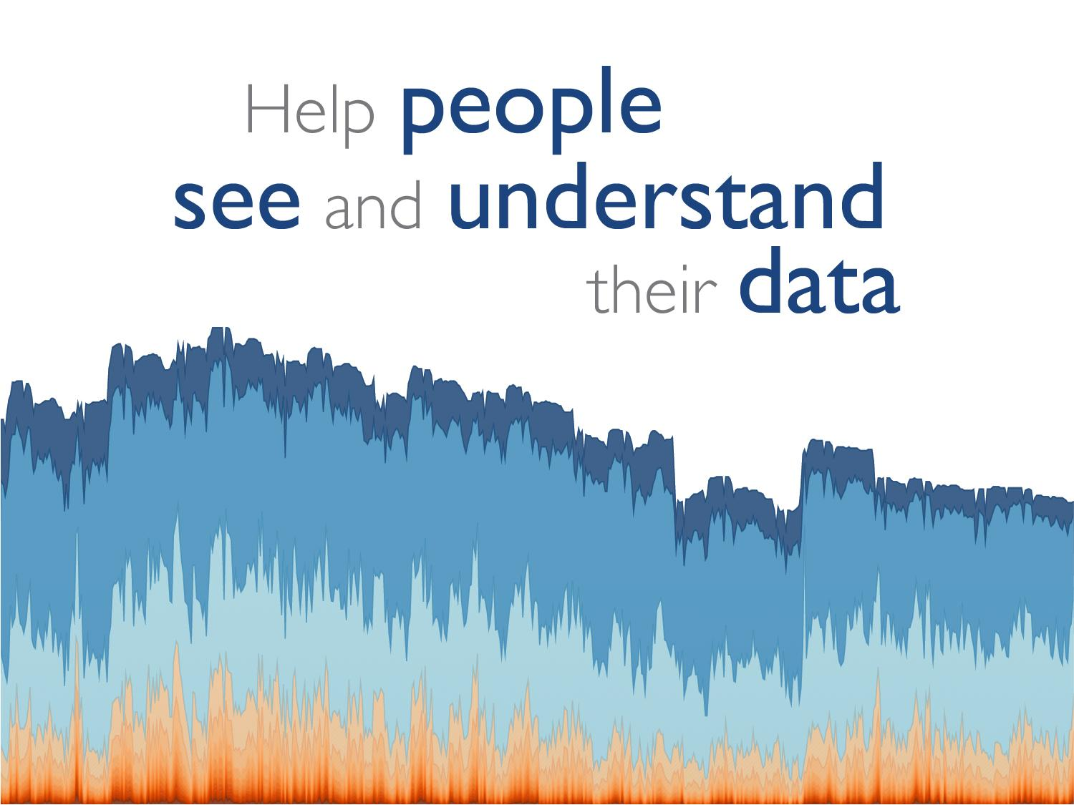
Notes:
The key words are see, understand, and people. Tableau builds software for people, not specialists. We believe anyone should be able to harness the power of data. That’s our mission.

Slide 68

Notes:
Thank you for your time today, at this point we can open it up for any questions you might have.

